Slide 2
More than one way to “win a hat”
Dr Leslie Robinson, Honorary Reader, University of Salford
Janice St John –Matthews, University of West of England

Slide 3
Plan
Definitions
Awards and routes
QAA descriptors
Meet our panel of “experts by experience”
Exercise: Self-analysis exercise
Why do I want to do this?
What will be the end goal?
What resources do I have
The panel shares their experiences
Group exercise
Three burning questions
Answers from audience members who’ve been through it

Slide 4
Full title | Abbreviation | Description
Doctor of Philosophy | PhD | PhD is the most common award title at Doctoral level. PhD is traditional route.
Doctor of Philosophy | DPhil | Used for subject specialist doctorates at small number of HEIs, as an alternative to the title PhD. Can also be used to refer to doctorates by publication.
Professional Doctorate | Prof Doc Or DProf | Aim to develop an individual's professional practice and to support them in producing a contribution to (professional) knowledge. Usually substantial taught element
Doctor of... | D[subject abbreviation] or [subject abbreviation] e.g. For education.. D.Ed or EdD | Professional and practice based doctorates within a specialised subject, e.g.: Doctor in Health Sciences Doctor in Health Research Doctor of Education Usually substantial taught element
Phd by Published Work/s | PhDPW PhD by portfolio Dphil | Awarded in recognition of a substantial body of original research undertaken over the course of many years. Typically a portfolio of work that has been previously published in a peer-refereed context is submitted for assessment

Slide 5
Full title | Abbreviation | Description
Doctor of Philosophy | PhD | PhD is the most common award title at Doctoral level. PhD is traditional route.
Doctor of Philosophy | DPhil | Used for subject specialist doctorates at small number of HEIs, as an alternative to the title PhD. Can also be used to refer to doctorates by publication.
Professional Doctorate | Prof Doc Or DProf | Aim to develop an individual's professional practice and to support them in producing a contribution to (professional) knowledge. Usually substantial taught element
Doctor of... | D[subject abbreviation] or [subject abbreviation] e.g. For education.. D.Ed or EdD | Professional and practice based doctorates within a specialised subject, e.g.: Doctor in Health Sciences Doctor in Health Research Doctor of Education Usually substantial taught element
Phd by Published Work/s | PhDPW PhD by portfolio Dphil | Awarded in recognition of a substantial body of original research undertaken over the course of many years. Typically a portfolio of work that has been previously published in a peer-refereed context is submitted for assessment
These are ALL doctoral degrees
Quality Assurance Agency
The Frameworks for Higher Education Qualifications of UK Degree-Awarding Bodies
Level 8 (level 12 Scotland)

Slide 6
QAA (2014) Descriptor for a higher education qualification at level 8 on the FHEQ and SCQF level 12 on the FQHEIS: doctoral degree

Slide 7
QAA doctoral degree descriptors
Doctoral degrees are awarded to students who have demonstrated:
Creation of new knowledge, through original research of a quality to satisfy peer review, extend forefront of discipline, and merit publication
Acquisition and understanding of a substantial body of knowledge which is at the forefront of an academic discipline or area of professional practice
Ability to conceptualise, design and implement a project to generate new knowledge, applications or understanding at the forefront of the discipline, & adjust project design in light of unforeseen problems
Detailed understanding of research technique and advanced academic enquiry.
And holders will have:
Qualities and transferable skills to exercise personal responsibility & largely autonomous initiative in complex &unpredictable situations, in professional or equivalent environments.
Adapted from QAA (2014) Descriptor for a higher education qualification at level 8 on the FHEQ and SCQF level 12 on the FQHEIS: doctoral degree

Slide 8
Meet our expert panel

Slide 9
Lecturer
Senior Lecturer
Snr Rad
Snr Rad
&
P/T
Lecturer
Lecturer
Academic Director for AHPs
Lecturer
Senior Lecturer
Lecturer
Associate professor
Snr Lecturer
Head of Directorate Rad
Ace
Jack
Jet
Rod
Roma
Sam
PhD
NIHR funded
Full time
PhD by Published Works
DProf. Research in Health Professions Education
Part time
Part time PhD
CoR Doctoral Fellowship
Part time
Professional Doctorate
Part time
PhD
Part time
Aortic stents
Radiation dose and image quality
Crowd sourcing in rad education
Haemodynamics in bone tissue
Radiography cultures
Interprofessional education

Slide 10
Representative?
 | Completed Nº (%) | In Progress Nº (%) | Total Nº (%)
EdD | 5 (11.4) | 10 (21.7) | 15 (16.7)
PhD | 26 (59.1) | 21 (45.7) | 47 (52.2)
PhD by Published Works | 5 (11.4) | 3 (6.5) | 8 (8.9)
Prof Doc | 8 (18.2) | 12 (26.1) | 20 (22.2)
Total | 44 | 46 | 90
Doctoral Route Taken by Radiographers (Snaith et al 2016)
“ 63.3% of respondents (n = 57/90) working solely within a university, and a further 10% employed in a clinical–academic role (n = 9/90)”

Slide 11
Why our experts took these routes
Traditional PhD | “I saw more value in just having a PhD. Believed Prof doc not equivalent to PhD. Just a personal view at the time but may still be viewed like this” (Sam, Senior Lecturer) “As a full time lecturer not in clinical practice, this was most appropriate” (Rod, lecturer)
Professional Doctorate | “I wanted some research training, I also wanted some time to develop my (then embryonic) research ideas & I also wanted to be part of a cohort in order to have peer support” (Roma, lecturer) “Wanted to do something more ‘applied’ “ (Jet, lecturer)
PhD by Published Works | “It was the only route available to me from a financial point of view; I could not afford to stop working to do a traditional PhD “” (Jack, practitioner)

Slide 12
Is a doctorate right for you?
Preparing myself for doctoral study
Informed decision
Self:
What are my skills and knowledge?
Route:
Which is most appropriate?
My Life:
Will it accommodate doctoral study?
Value:
How will I benefit from having a doctorate?
Self:
What are my attitudes and attributes?

Slide 13
Is a doctorate right for you? Self-analysis exercise
Complete the first box in the workbook (5mins)
If you already have a doctorate – does having a doctorate fulfil your original aims?
If you are in the process of completing a doctorate – it’s worth reviewing this question to re-evaluate your motivation
If you are comfortable to do so, share your thoughts with the group (5mins)
Were there any common themes or questions?

Slide 14
 | Advantages
Traditional PhD FULL TIME funded | Time release Peer support – research community at university and from NHS Research training events
Traditional PhD PART TIME | Being able to do one big piece of substantial research rather than small modules Link research to job Well trodden traditional path = support available through university CoR Doctoral Fellowship Grant = put on the local NIHR Clinical Research Facility Portfolio=further support including lab facilities, nurse support and research support such as statistical support
Professional doctorates | Getting research training and development Peer support Part time so can stay employed Link research to job Intermediate terminating qualifications
PhD by Published Works | Developed writing skills Research outputs accumulated along the way Supervision: university support and clinical support

Slide 15
 | Advantages
Traditional PhD FULL TIME funded | Time release Peer support – research community at university and from NHS Research training events
Traditional PhD PART TIME | Being able to do one big piece of substantial research rather than small modules Link research to job Well trodden traditional path = support available through university CoR Doctoral Fellowship Grant = put on the local NIHR Clinical Research Facility Portfolio= further support including lab facilities, nurse support and research support such as statistical support
Professional doctorates | Getting research training and development Peer support Part time so can stay employed Link research to job Intermediate terminating qualifications
PhD by Published Works | Developed writing skills Research outputs accumulated along the way Supervision: university support and clinical support
You will get lots of support!

Slide 16
 | Disadvantages
Traditional PhD FULL TIME funded | Application process competitive, long and difficult Lose touch with own discipline-based community
Traditional PhD PART TIME | Managing time – still had day job Mental health at risk, stressful Challenging/changing fundamental belief system exhausting
Professional doctorate | Lot of work in taught element – some modules not useful Not recognised by some bodies/institutions e.g. NIHR (changing now)
PhD by Published Works | Time – no time release Tiredness

Slide 17
 | Disadvantages
Traditional PhD FULL TIME funded | Application process competitive, long and difficult Lose touch with own discipline-based community
Traditional PhD PART TIME | Managing time – still had day job Mental health at risk, stressful Challenging/changing fundamental belief system exhausting
Professional doctorate | Lot of work in taught element – some modules not useful Not recognised by some bodies/institutions e.g. NIHR (changing now)
PhD by Published Works | Time – no time release Tiredness
It’s hard work!

Slide 18
Do you recommend studying for a PhD? All experts said yes but with caveats:
Do you need it for your job/role?
Do you want to be a researcher or have research as a significant element of your role?
Do you have motivation and tenacity?
Do you have the time?
Get funding if possible: (time, access to support)
Fit your skills, capabilities & resource to the routes
For traditional PhD need relevant skills to be an independent learner straight away
Prof doc will give you development and training
PhD by PW if you have/want publications but can you write?

Slide 19
Which university?
Academics: own or other?
Working at one institute but studying at another – systems and culture different . Need to book supervisors weeks in advance (Jet)
Undertaking a PhD within my University has allowed a great support network, but it has added some pressure to my project as it is an inherent part of my role (Rod)
Clinical radiographer
Seek out subject expertise and support
Convenience of location
Is your preferred route offered?

Slide 20
Questions and answers
In your group come up with three ‘burning questions’ - you have 5 minutes to do this
Let’s create some answers between us
Complete the remainder of the workbook after the workshop

Slide 21
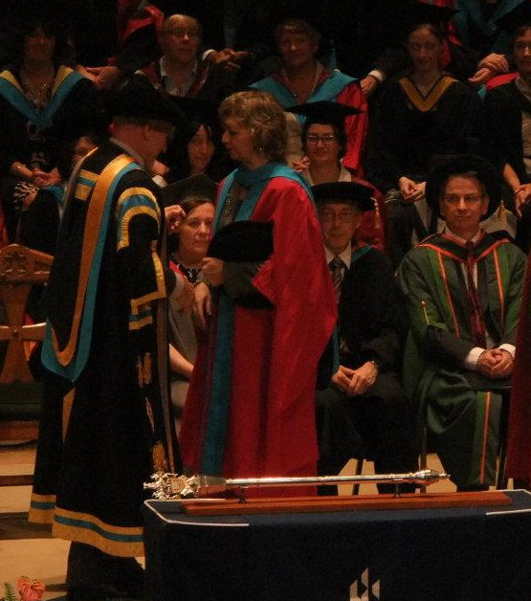
Me!
Sir Patrick Stewart – aka Jean-Luc Picard!
Chancellor of University of Huddersfield
(2004-2015)

Slide 22
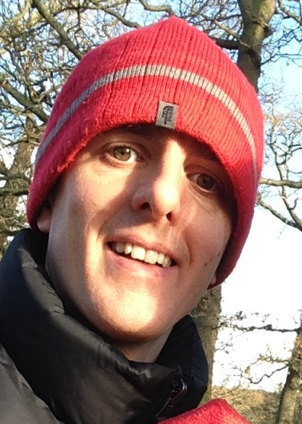
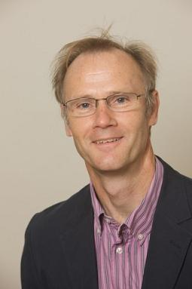
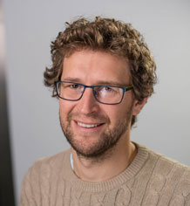
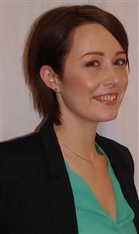
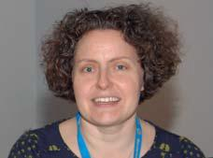
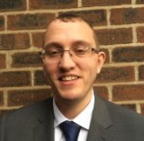
Acknowledgements: panel of experts
Dr Stuart Mackay
Dr John Thompson
Dr Andrew England
Dr Ruth Strudwick
Robert Meertens
Janice St John Matthews

Slide 23
References and Resources
College of Radiographers Doctoral Fellowship Grant https://www.sor.org/about-us/awards/college-radiographers-doctoral-fellowship-grant
College of Radiographers Researchers Page https://www.sor.org/career-progression/researchers
Gardner, S. K., & Gopaul, B. (2012). The part-time doctoral student experience. International Journal of Doctoral Studies, 7, 63-78. Retrieved from www.scopus.com
Geraghty, S., & Oliver, K. (2018). In the shadow of the ivory tower: Experiences of midwives and nurses undertaking PhDs. Nurse Education Today, 65, 36-40. doi:10.1016/j.nedt.2018.02.017
Jobs.ac.uk: International job board for careers in academic, research, science and related professions. Operated by the University of Warwick https://www.tcd.ie/Careers/downloads/should-i-do-a-phd.pdf
National Institute for Health Research Clinical Doctoral Research Fellowship funding and support information https://www.nihr.ac.uk/funding-and-support/funding-for-training-and-career-development/training-programmes/nihr-hee-ica-programme/nihr-hee-ica-programme-cdrf.htm
QAA UK Quality Code for Higher Education (2014) http://www.qaa.ac.uk/en/Publications/Documents/qualifications-frameworks.pdf
Snaith B, Harris MA, Harris R (2016) Radiographers as doctors: A profile of UK doctoral achievement. Radiography Volume 22 , Issue 4 , 282 - 286
Vitae: resource supporting the professional development of researchers https://www.vitae.ac.uk/doing-research/are-you-thinking-of-doing-a-phd/should-you-do-a-doctorate-in-the-uk
Images acquired from https://www.sketchappsources.com/free-source/2398-cartoon-characters-avatars-sketch-freebie-resource.html

