Slide 1

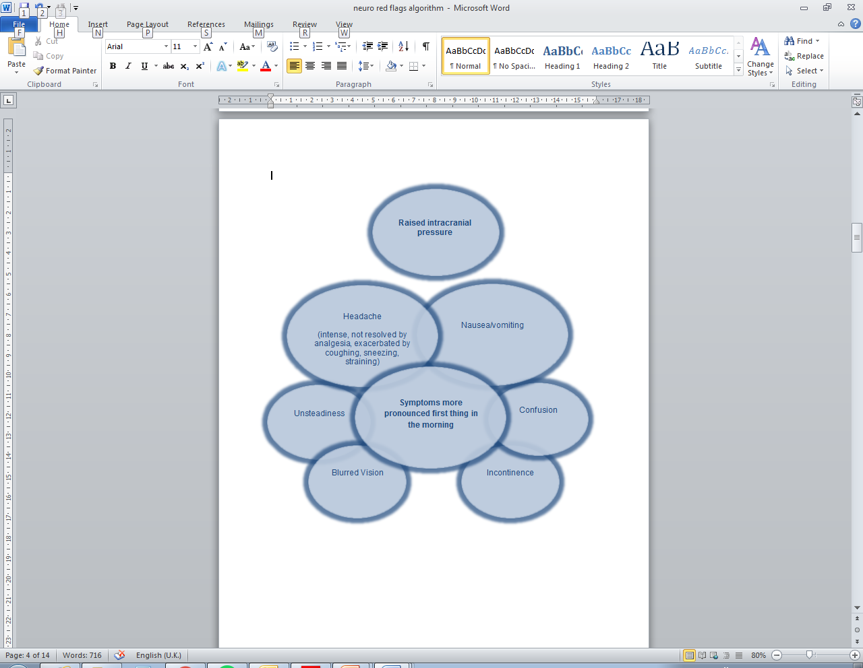
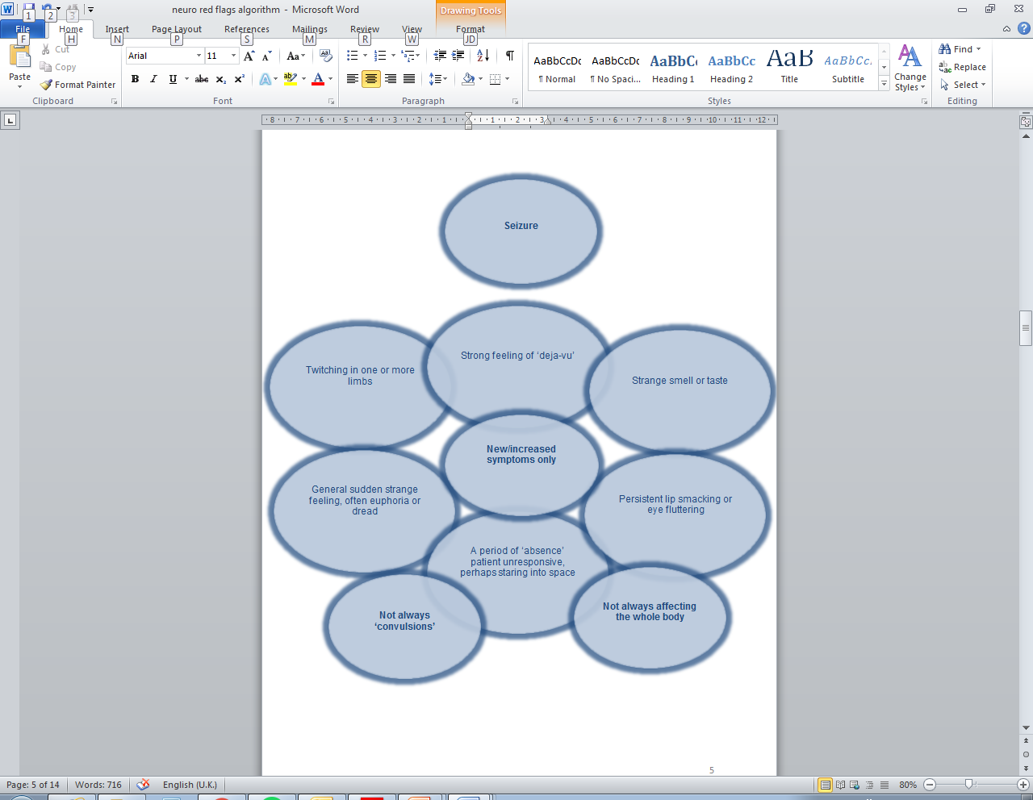
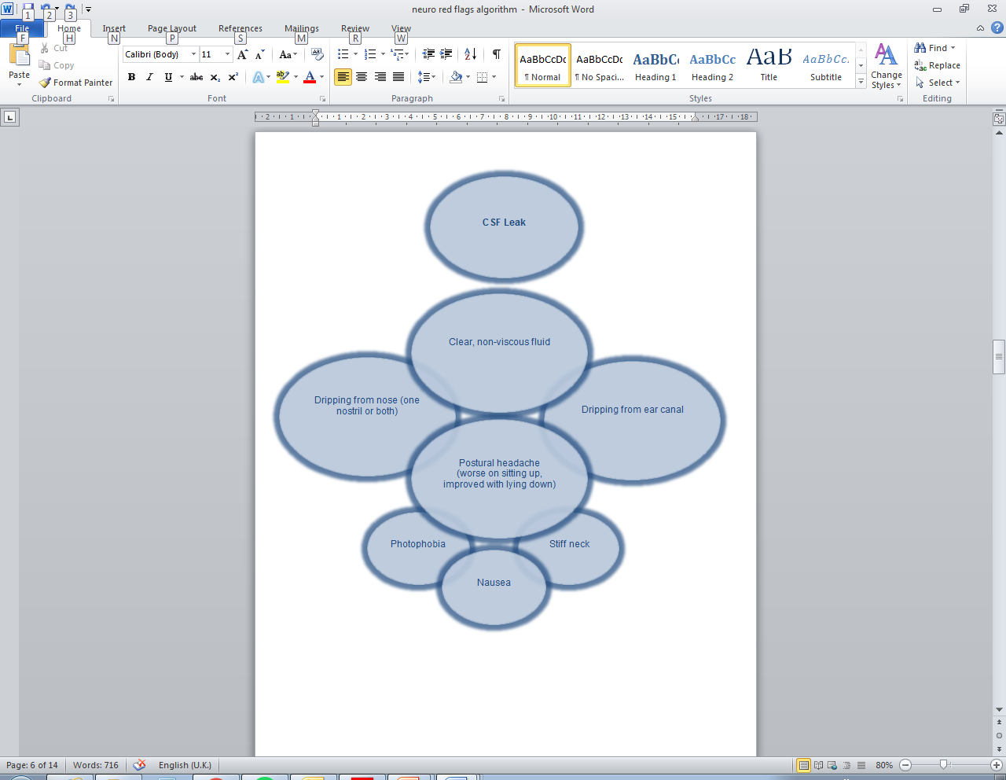
DESIGN AND IMPLEMENTATION OF A RADIOGRAPHER-LED NEURO-ONCOLOGY TRIAGE TOOL
Rhona Watson, Neuro-oncology Advanced Practitioner Radiographer (rhona.watson@ouh.nhs.uk),
INTRODUCTION
The Oxford multi-disciplinary radiotherapy (RT) practice development team have designed a series of site specific radiographer-led triage tools to support assessment of RT side-effects and ensure consistency of action taken. Discussion with treatment radiographers highlighted that they felt daunted when discussing RT side-effects with neuro-oncology patients due to the complexity of their disease and its management. Symptoms reported during RT may not necessarily be a side effect of RT alone but could be a complication of neurosurgery, medication (e.g. steroids, anti-epileptic drugs), chemotherapy, RT or a combination. Therefore, it was felt by the group that a tool which facilitated identification of common adverse events (AEs) rather than radiographer-led side effect management was more appropriate.
DESIGN
The idea of symptom ‘clusters’ in patients having RT to the brain was explored¹ and the tool takes inspiration from the format of a Venn diagram, highlighting that symptoms may overlap and particular symptom clusters will point to a differential diagnosis. Upon discussion with the neuro-oncology team, likely AEs (e.g. raised intracranial pressure, seizures, DVT/PE, infection, wound complications, CSF leak) were collated and their features broken down and recorded in a series of cluster diagrams.
Teaching sessions were delivered by the neuro-oncology team in parallel to initial roll out of the tool.
PURPOSE
Radiographers are not expected to manage these conditions, the tool is intended to be used as a prompt to ask appropriate questions and build a concise history, giving staff confidence to recognise and escalate the problem for management by a member of the neuro-oncology team or on-call medical staff if an AE is suspected. The tool can be accessed on any workstation and a copy may be printed to enable its use as a visual aid during discussion with patients.
IMPLEMENTATION
Teaching sessions were delivered to all radiographers by the neuro-oncology team in parallel to initial roll out of the tool.
Formal audit revealed that the tool has been well received and radiographers feel more confident in addressing concerns of neuro-oncology patients and referring on to medical staff for assessment.
Staff reported the tool was concise and qucick and easy to use.
One negative point raised was that the paperless format of the document means it is not always accessible in the RT treatment room during discussion. New equipment and a move to paperless radiotherapy will enable radiographers to call up the document on-screen in the treatment room while assessing patients side-effects on a daily basis.
REFERENCES:
1.Chow, E. et al (2008), ‘Symptom clusters in cancer patients with brain metastases’, Clinical Oncology, 20:76-82.

