Slide 2
Welcome

Slide 3
Advanced Practitioner (interventional) and the Progress to Consultant / Trainee Consultant
Cat Lee

Slide 4

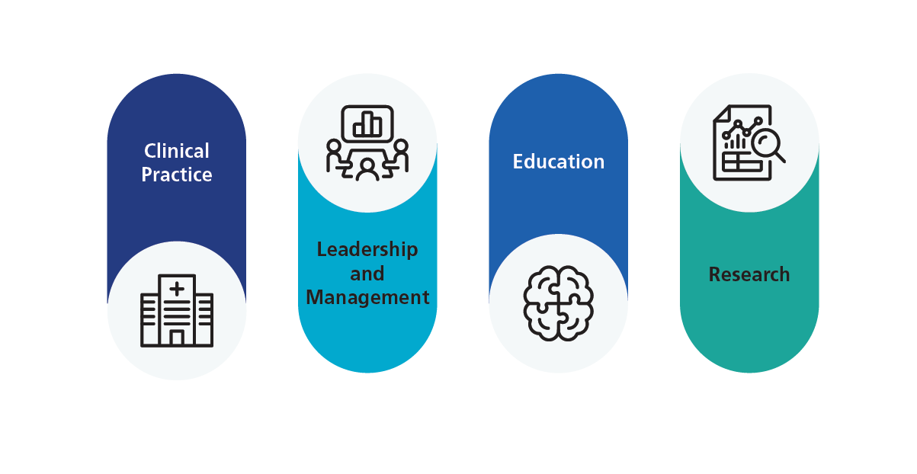
My role
Trainee Consultant Radiographer Sonographer
Notes:
So what is my role, what does it include?
To begin with…...As a new role in my trust, *** it felt a bit like nobody knows
While I am not a trail blazer in a role like this nationally, I am shaping my role in my own organisation, which can be confusing and exhausting- but gives me an opportunity to shape the role around the ***four pillars of practice, which has been an opportunity to develop a better understanding of governance, process and educational or leadership theories

Slide 5
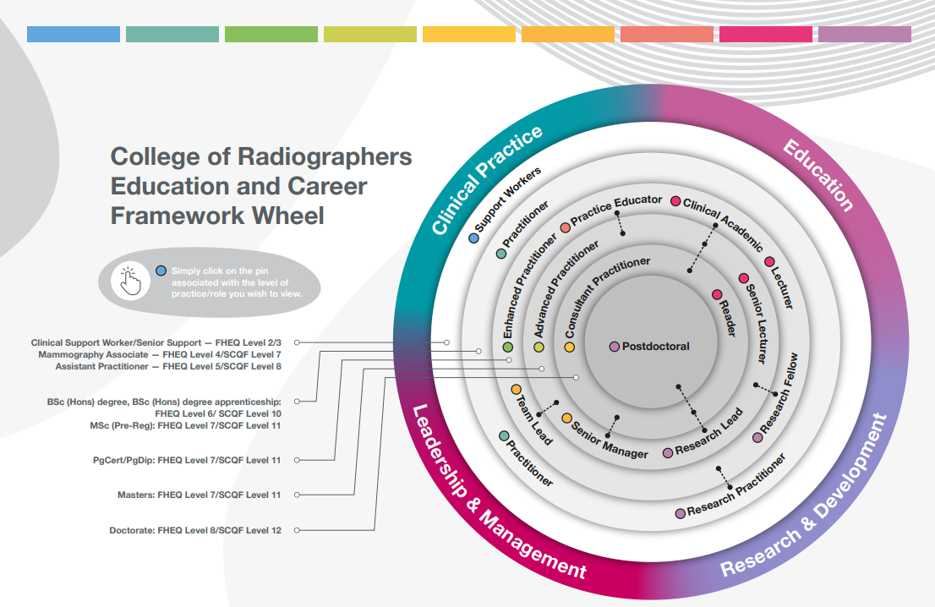
Notes:
Looking at the career framework wheel- I sit here in the clinical practice area transitioning from advanced to consultant practice role, with some overlap into the clinical academic role given that I spend 50% of my time completing my PhD

Slide 6

Clinical Practice
GMUS
Gynae
Testicular
DVT
H&N
POCUS/FAMUS
Interventional procedures
Expert Witness
Notes:
I have expert knowledge across a range of standard US specialities
And then in addition I have my interventional practice- FNA, Biopsies, Drainages, Neph Exchanges. I am able to manage complex episodes of care independently.
Recently I have also undertaken expert witness training- but am yet to take a case on

Slide 7

Leadership & Management
NOT a superintendent/Principal/Lead
UAG Chair
Regional US Group Vice chair
SIGs
QSI role
Local project management
Line management
Doing appraisals
Preceptorship/coaching/ mentoring
Policy development
QI projects
Learning funding bids
Notes:
I often hear that people don’t want to progress through the career framework, because they don’t want to “manage” or move away from their clinical skills. Good managers are critical to the success of a department while ensuring good, safe patient care- but this role is not for everyone, and you don’t need to be in one of these roles to demonstrate leadership skills which ultimately improve services for patients and ensure staff want to remain in departments. ***You can however draw on your expert clinical knowledge to influence local, regional or even national guidance using project management and strategic skills in a well established network that you create over the years of your practice- at events like this! This all counts as evidence for leadership at advanced and consultant level according to national frameworks.

Slide 8



Education
Student Assessor
Preceptor¹
HEI guests lectures and teaching
Study lectures
LTHE qualification
POCUS/FAMUS faculty
Departmental CPD/learning
SLEC²
CASE accreditation process
My own learning needs and development
1. elearning for healthcare. Multi-Professional Preceptor e-Compendium [Internet]. [cited 2026 Feb 23]. Available from: https://www.e-lfh.org.uk/programmes/multi-professional-preceptor-e-compendium/
2. NHS England. Safe Learning Environment Charter [Internet]. [cited 2026 Feb 23]. Available from: https://www.england.nhs.uk/mat-transformation/safe-learning-environment-charter/
Notes:
Education is complex- and often underestimated in my opinion. There is real skill and knowledge in effective teaching and assessment- promoting a culture of reflection and ensuring the learner is empowered to identify their own strengths and weaknesses, and then coaching alongside them to develop plans to address any gaps in knowledge or skills. You need to be inclusive in your approach and your practice must be rooted in sound theory or pedagogy. In enhanced level of practice you tend to work in a model of education that is served or delivered to you; seeking feedback and being reflective about your own practice. Then moving through to advanced and consultant practice where you become more involved in teaching others and working with HEIs contributing to curriculum, and teaching regionally or nationally.

Slide 9

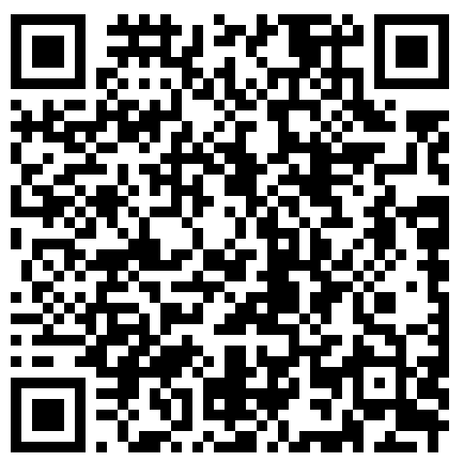
Research
Local audits
MSc- UKIO presentation and nominated as BMUS Young Investigator of the year
Led to service re-design locally
Peer reviewer for Radiography
Posters at conferences
Shortlisted for Ultrasound pitch pump prime grant
NIHR GCP³- able to recruit participants for clinical trial
PhD
3. National Institute for Health and Care Research (NIHR). Good Clinical Practice (GCP) [Internet]. [cited 2026 Feb 23]. Available from: https://www.nihr.ac.uk/career-development/clinical-research-courses-and-support/good-clinical-practice
Notes:
Often the hardest pillar to occupy- but I started small with departmental audits, moving onto an MSc dissertation, took the plunge and applied abstracts for conferences, and have shortlisted for awards (not won anything yet….but that is very common in research- experiencing very many setbacks before successes with funding bids). Some accessible, cheap research activities are peer reviewing and undertaking the NIHR Good clinical practice online training. I’m now undertaking my PhD at the University of Exeter

Slide 10
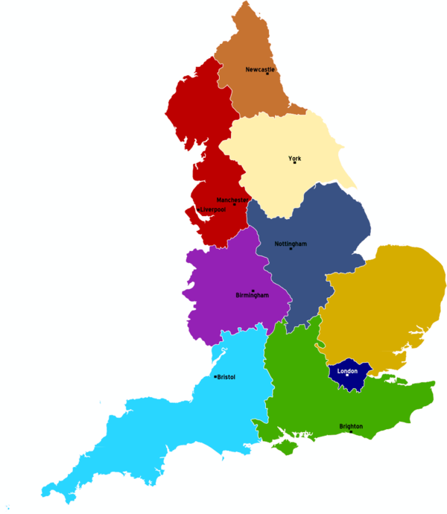

My career pathway
Porter
Superintendent
Industry
This Photo by Unknown Author is licensed under CC BY-SA
BSc DRAD
Ultrasound PG Dip
MSc Ultrasound
PhD (Tr Cons Sono)
CT/MRI/Fl
Military tour
MSc ACP (AP Sono)
Notes:
***I started as a porter in 2002, not knowing what I wanted to do with myself and spent a lot of time taking patients to and from X-Ray. My Dad “subtly” circled the course in the clearing section of the paper and as equally “subtly” suggested I should call the Uni- ***a week later I found myself in a different country (Wales!) beginning a degree.
***I was always ambitious and wanted to have more to do with patient’s journeys than taking the images. ***After a deployment to Afghanistan, the opportunity*** to train in Ultrasound arose and I grabbed it. ***Not long into my career I accidentally found myself as a superintendent, ***before spending some time as an applications specialist- but I missed the true clinical environment.
After being a reporting sonographer for a while, the opportunity arose to apply as superintendent in a different department- but I didn’t get the job. Then later to be an advanced practice sonographer, but again I didn’t get the job. ***So I spent the next year or so exploring what I needed to do to be ready for the next advanced practice role, while undertaking my MSc. The next job I was successful, ***and completed my ACP MSc via the apprenticeship route (which is ACP accredited) and am ***soon to have my role title changed to Consultant Sonographer, and have commenced my PhD.
Until my goal of becoming an advanced practitioner emerged- ***everything along this pathway was accidental and tortuous geographically!

Slide 11
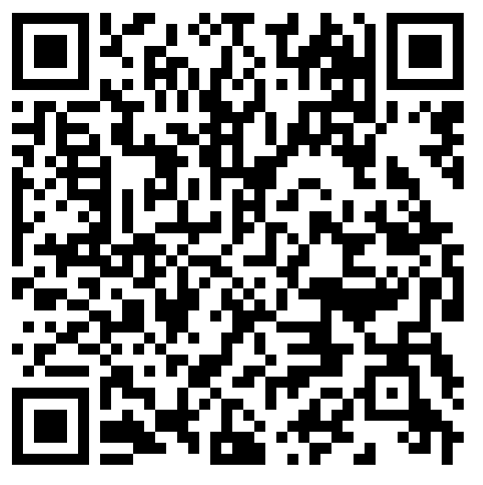
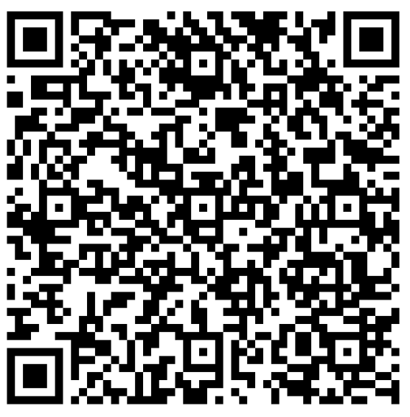
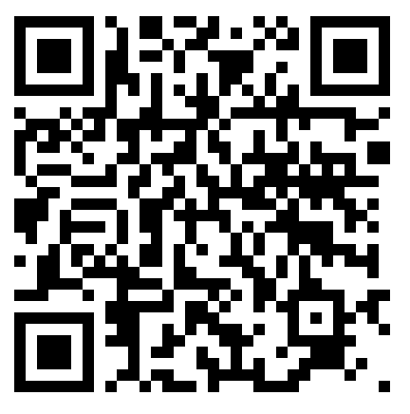
How I got here…my advice
Always volunteer for seek out development opportunities
Map them to the ECF⁴ and BMUS⁵ preceptorship
Ask for and use PDRs as opportunities to plan these activities with your line manager
Take risks and be vulnerable
4. Society and College of Radiographers. Education and Career Framework for the Radiography Workforce [Internet]. [cited 2026 Feb 23]. Available from: https://www.sor.org/getmedia/1ec4e156-d832-4ba9-a4e8-cab8106e6927/ScoR-ECF-Interactive-v10a-1
5. British Medical Ultrasound Society. Preceptorship and Capability Development Framework for Sonographers [Internet]. July 2022 [cited 2026 Feb 24]. Available from: https://www.bmus.org/static/uploads/resources/Preceptorship_and_Capability_Development_Framework_for_Sonographers.v5_002.pdf
6. NHS Leadership Academy. Programmes [Internet]. [cited 2026 Feb 24]. Available from: https://www.leadershipacademy.nhs.uk/programmes/
Notes:
Look for cheap and easy wins. SIGs, webinars, Centre for Advancing practice, SOR, BMUS, eLearning for health, NHS leadership online courses- Edward Jenner for example

Slide 12
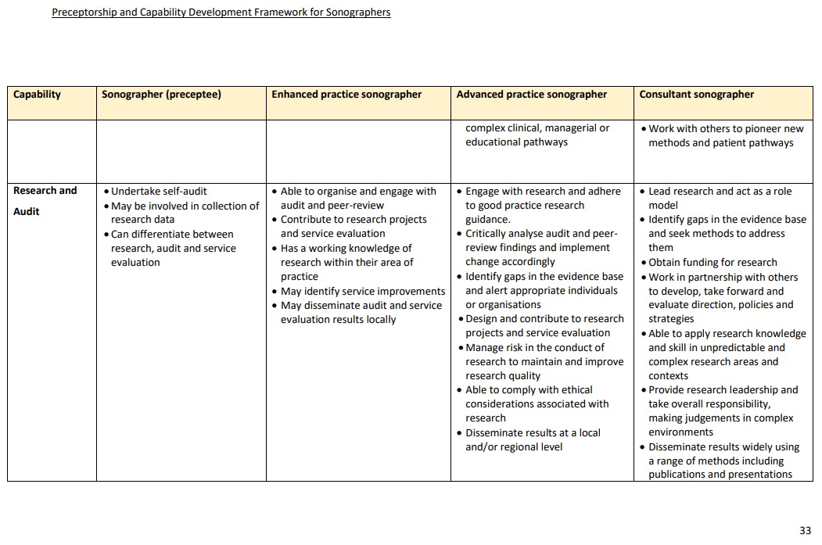
5. British Medical Ultrasound Society. Preceptorship and Capability Development Framework for Sonographers [Internet]. July 2022 [cited 2026 Feb 24]. Available from: https://www.bmus.org/static/uploads/resources/Preceptorship_and_Capability_Development_Framework_for_Sonographers.v5_002.pdf
Notes:
The BMUS preceptorship guidance contains some really good examples of things you can do to develop and then use a evidence in your CPD portfolio and draw on for job applications and interviews

Slide 13

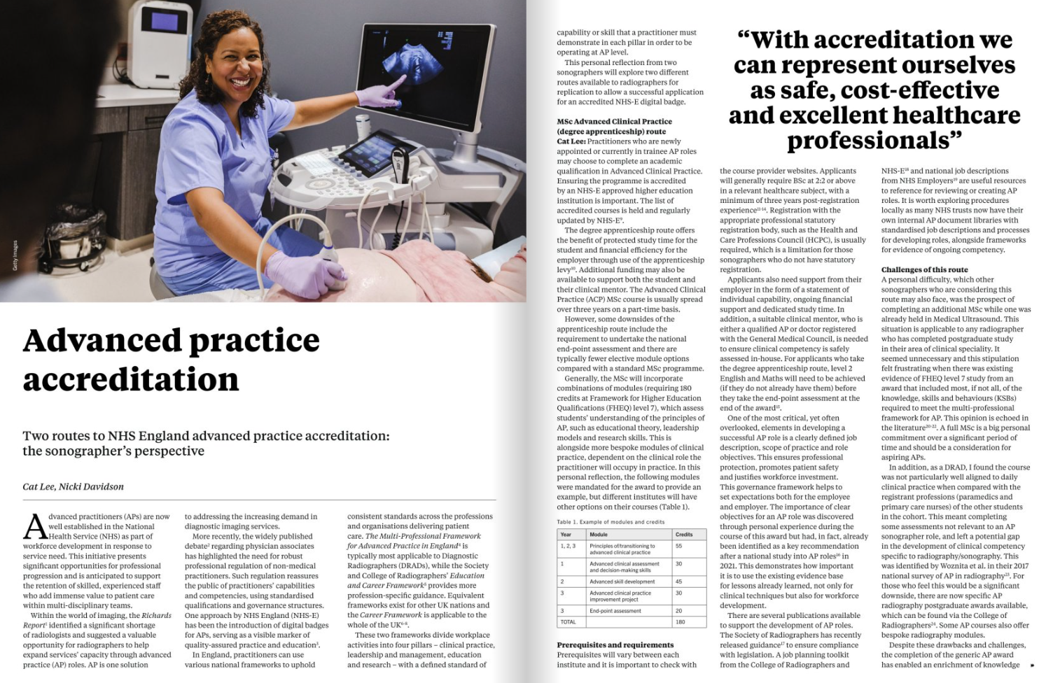
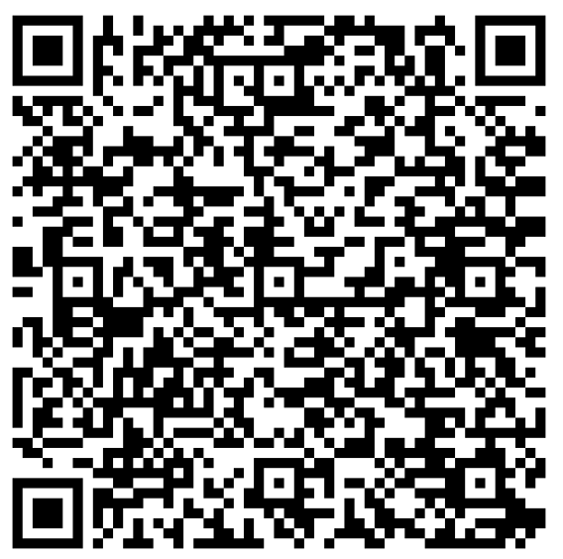
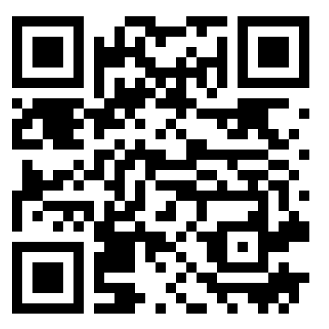
7. Society and College of Radiographers. Insight | Edition 17: Autumn 2025 [Internet]. 2025 Sep 24 [cited 2026 Feb 24]. Available from: https://www.sor.org/learning-advice/professional-body-guidance-and-publications/documents-and-publications/imaging-therapy-practice/insight-edition-17-autumn-2025
8. NHS England. Advanced Practice (Centre for Advancing Practice) [Internet]. [cited 2026 Feb 24]. Available from: https://advanced-practice.hee.nhs.uk/
Notes:
Seek out an accredited course. I have recently learnt that there is a similar route coming for Consultant Practice- so watch this space as that is rolled out. Check with your Trust what their AP and CP governance and guidelines are- AP leads etc. This article in Insight might help you with the choice between ePortfolio or MSc accredited course route.

Slide 14
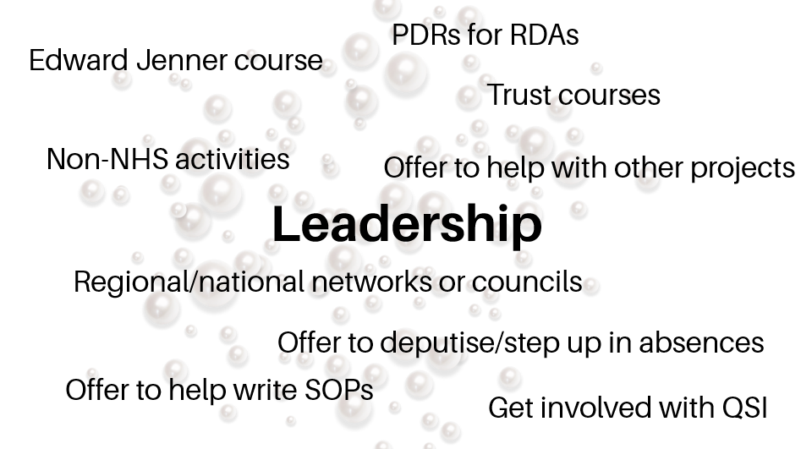
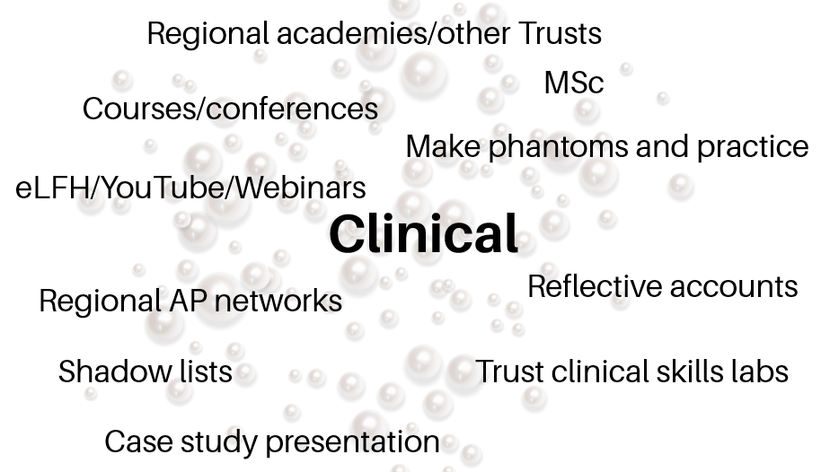
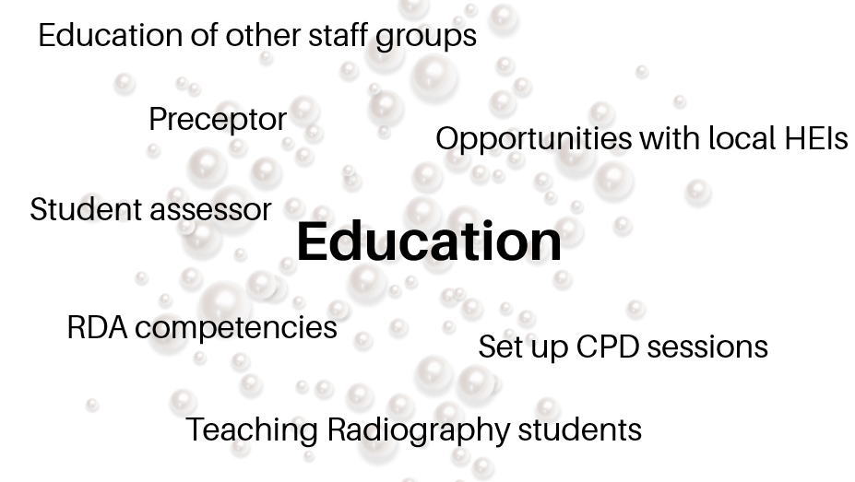
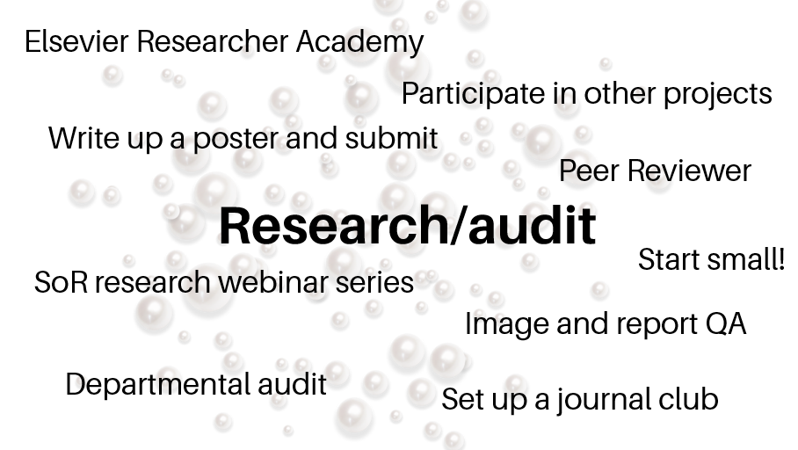
Notes:
So here are some examples of things I did to prepare for applying for my AP role. Funding- all AHPs are entitled to funding for CPD- Ask at your Trust. Or look for grants and funding with SoR/NIHR/BMUS

Slide 15
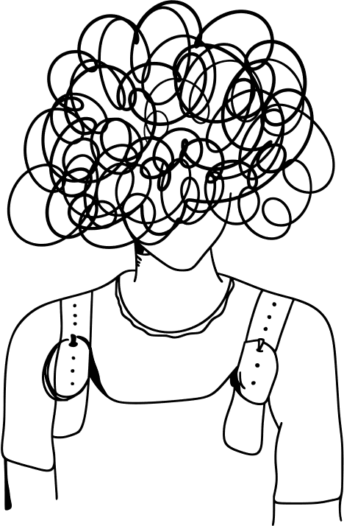
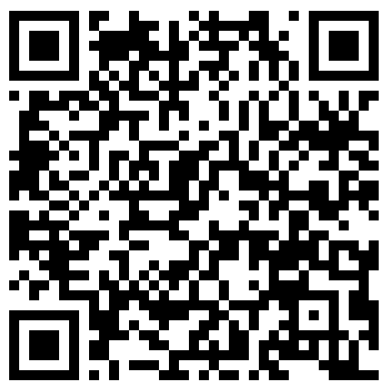
What I wished I’d known earlier
Clear job plan outlined from outset
Good governance⁹
Be creative with your development- may take dedication and sacrifice
Be realistic with a sprinkle of ambition- align goals with department/Trust strategies
Advocate our roles and use existing frameworks and literature to support your cause
Be brave. Prepare for rejection, and be kind to yourself. Feedback is a gift!
Try again, might not be successful first time round
9. Lee C. CPD Shorts: Governance for sonographers [Internet]. Society and College of Radiographers; 2025 Nov 10 [cited 2026 Feb 24]. Available from: https://www.sor.org/news/cpd/cpd-shorts-governance-for-sonographers
Notes:
This is a graphical representation of how my role functions in my head! It has been stressful and it can feel like I am pulled in many directions….because you have be across all 4 pillars, meeting the framework stipulations.
A way to reduce this confusion, lack of clarity and feeling like you are constantly firefighting is get a job plan nailed down from the outset…..You may end up knowing more about AHP job planning than your manager, but it is coming for us all……get ahead of the curve and look out for resources from the SoR with example job plans and scopes of practice….and NHS E AHP job planning guidance.
I am currently 50/50 clinical and the other pillars due to me doing my PhD (your job plan will need to be specific for your job at that time, and commonly quoted AP splits are 80/20)
Don’t feel guilty for not being clinical 100%....these other pillars contribute to the governance and sustainability of the future sonography workforce., and are as just as important as doing your clinical work.
***Support everything with good governance
***remember the cheap easy wins
***use existing Trust strategies to support your goals
***shout to whoever will listen about how AP/CP sonographer roles can improve patient outcomes- use national plans to back up your claims- like NHS cancer plan, NHS longterm plan, Richards report
***prepare to fail. Always ask for feedback and use it to improve- Emma Hyde UKIO
***Pick yourself up and try again

Slide 16
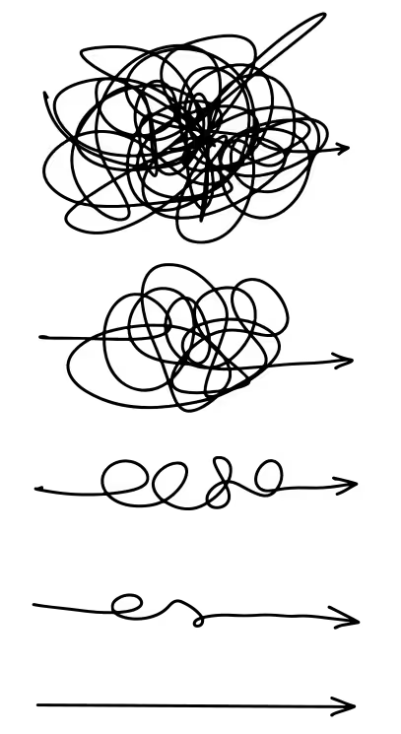
What I wished I’d known earlier
Clear job plan outlined from outset
Good governance⁹
Be creative with your development- may take dedication and sacrifice
Be realistic with a sprinkle of ambition- align goals with department/Trust strategies
Advocate our roles and use existing frameworks and literature to support your cause
Be brave. Prepare for rejection, and be kind to yourself. Feedback is a gift!
Try again, might not be successful first time round
9. Lee C. CPD Shorts: Governance for sonographers [Internet]. Society and College of Radiographers; 2025 Nov 10 [cited 2026 Feb 24]. Available from: https://www.sor.org/news/cpd/cpd-shorts-governance-for-sonographers
Notes:
Then hopefully some of that confusion and overwhelm will transform to clarity and get you moving in the direction you are aiming for.
Not going to lie…..it is hard work- but absolutely worth it. I have great satisfaction in my job and love the work I do.

Slide 17
The Practice Educator Role
Sharon Watty

Slide 18


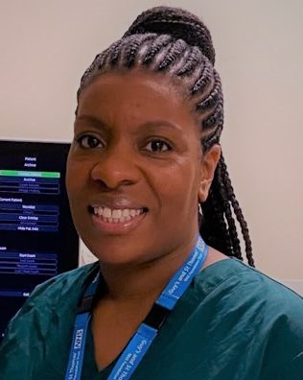
The Practice Educator Role
Sharon Watty s.watty@nhs.net
Practice Educator and Professional Development lead at Guys and St Thomas NHS Trust
Lead sonographer at SEL Ultrasound academy
Lecturer and module organiser at Kings College London
Notes:
Full time – 1 day a week in KCL 4 days with GSTT. 2-3 clinical lists.

Slide 19
My role
Personal Professional Development
Practice Education
Professional Development
Components of my role

Slide 20
My role – Practice Education
C
What is an Ultrasound Practice Educator?
L
R
Facilitates and organises education in the clinical environment
Work alongside clinical and academic colleagues to support learners
Support leaner to develop the professional skills to become an autonomous sonographer
Undertake practical assessments and assess competency
Create a learning environment for learners (comply with standards set nationally and by academic institution)
E
Notes:
If I asked names which you could associate with practice education – teaching training student sono. Important to define especially as many definitions relate to our AHP colleagues and of course like everything we in ultrasound are quite unique. Good SOR have define the role – but despit e this it is a very variable role and I willonly explain my own and own definition

Slide 21
My role – Practice Education
C
Trainees and Trainee Sonographers
L
Mentoring and supervision.
Know your learners
Giving feedback
Trainee rotations
Supporting academic workload.
Ensuring transition between lectures with clinical practice.
E
Notes:
As such most time is spent working with developing sonographers.
Plan their rotations (all trainees) and arrange training lists where possible
Mentoring and supervision. Interchangable between critical friend and professional supervision.
Supporting academic workload and marrying lectures with clinical practice.
Get to know the learners and be able to read, understand behaviour, skill development, techniques.
Giving feedback – knowing feedback models and knowing what works.
Support purchase and use of ultrasound simulation and phantoms

Slide 22
Practice Education
C
Trainees and Trainee Sonographers – Skill development
Interpretation and reporting
Professional skills (Communication, organisation)
Technical skill
E
L
Notes:
Observe expert practice, identify gaps, education, observe and feedback, stUdent resilience – QUIZES

Slide 23
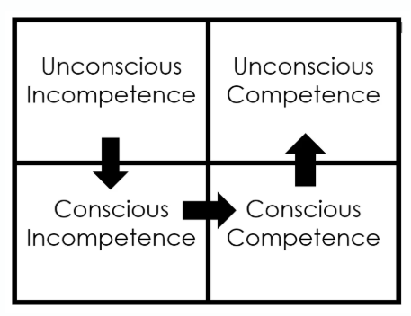
My role – Practice Education
Trainee Sonographers
Notes:
As such most time is spent working with developing sonographers.
Plan their rotations (all trainees) and arrange training lists where possible
Mentoring and supervision. Interchangable between critical friend and professional supervision.
Supporting academic workload and marrying lectures with clinical practice.
Get to know the learners and be able to read, understand behaviour, skill development, techniques.
Giving feedback – knowing feedback models and knowing what works.
Support purchase and use of ultrasound simulation and phantoms

Slide 24
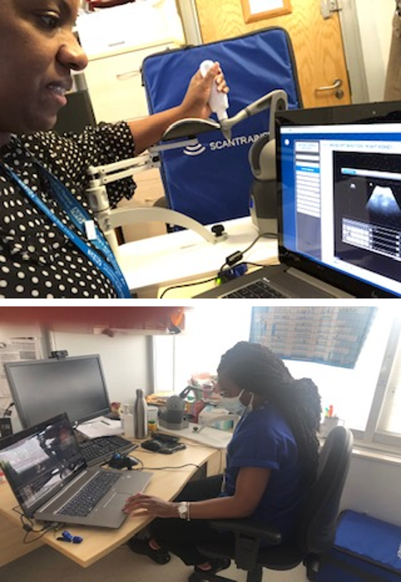
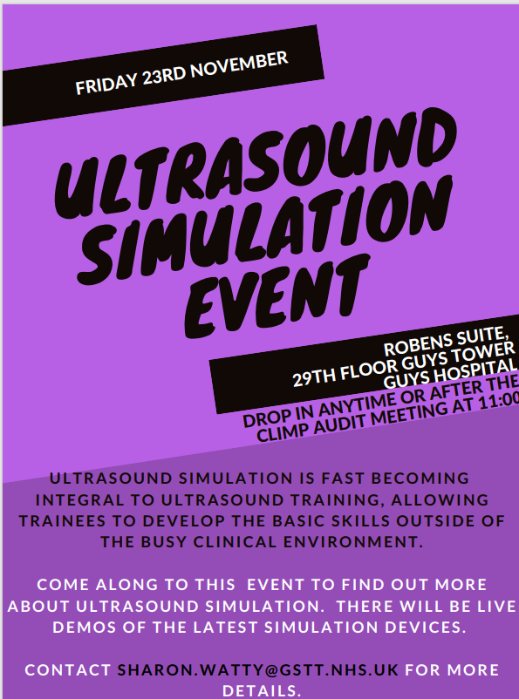
My role – Practice Education
Trainee Sonographers
E
Ultrasound Simulation
Ultrasound events
L
Notes:
As such most time is spent working with developing sonographers.
Plan their rotations (all trainees) and arrange training lists where possible
Mentoring and supervision. Interchangable between critical friend and professional supervision.
Supporting academic workload and marrying lectures with clinical practice.
Get to know the learners and be able to read, understand behaviour, skill development, techniques.
Giving feedback – knowing feedback models and knowing what works.
Support purchase and use of ultrasound simulation and phantoms

Slide 25
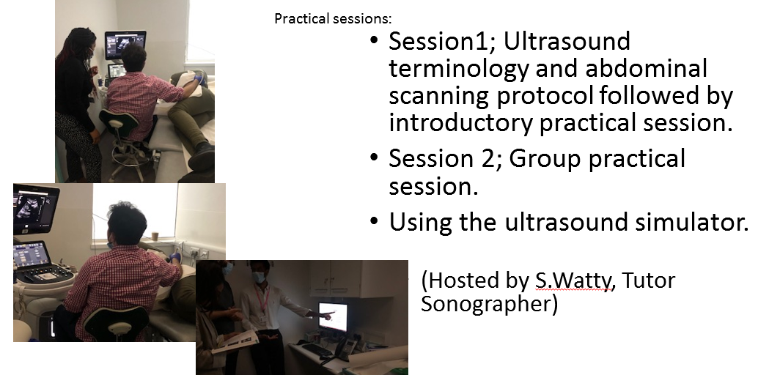


My role – Practice Education
Trainees, Trainee Sonographer and substantive staff
L
Recruitment and workforce planning.
Responding to local, national or regional directives.
Utilising and sourcing funding for education, new training rooms and equipment.
Notes:
Recruit trainee sonographers and forward plan their transition to B7 requires some workforce planning
Responding to local changes (recruitment freezes, lack of posts, workforce shortages – ensure appropriate preceptorship and protect long term career, understanding funding pathways and how to uttilise thems).
- Responding to national or regional directives – long term workforce, is there a better or different way to train.

Slide 26
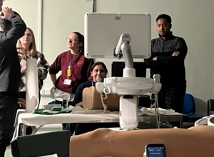
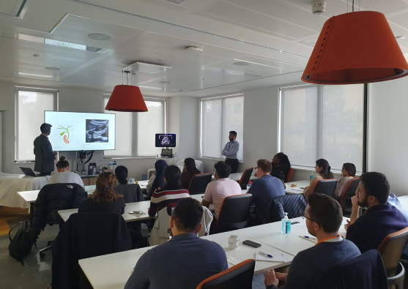

C
My role – Practice Educator
South East London Training Academy
L
Multi-disciplinary learning across SEL
Expert/ Consultant led lectures and tutorials .
Small group activity – include quizzes, 121 support, simulation
Supporting the development of LMS – online learning platform for Imaging.
Shared learning and networking, support practices and improve
placement capacity.
Working with industry to support education and learning
E
Notes:
Multidisciplnary (sonographers, ED doctors) across SEL
Consultant led lectures and tutorials – multi disciplinary. Whole day workshops focusing on 1 system including practical sessions. Small group activity – include quizzes, 121 support, simulation
Supporting the development of LMS – online learning platform for Imaging.
Increase CPD activity
Funding to support training in ultrasound (formally ended 2024-25).
Purchasing and developing new rooms, practice educators, funding support for trainees backfill, simulators and phantoms.
Working with HEIs to provide high level expert education
Regional support to streamline education – share practices and offering placement capacity.
Precetorship
Working with industry correct placement in line with national standards- elastography, lunch and learn

Slide 27
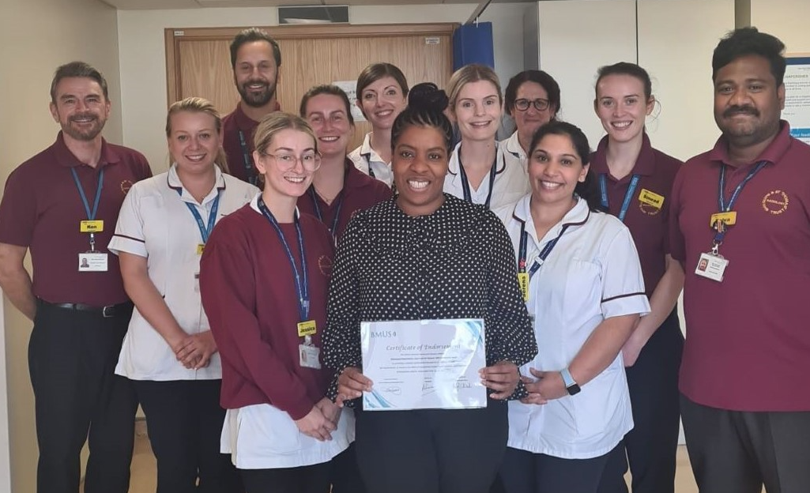
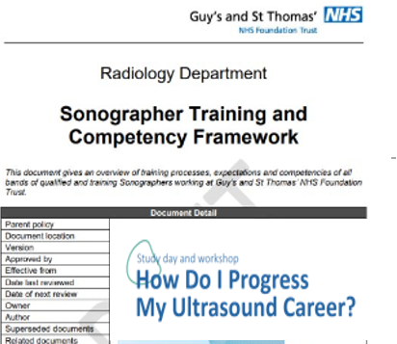
My role – Professional Development Lead
C
Maintaining professional standards, service development, quality improvement
Protocol development
IPC
Lead staff meetings
Inducting new staff
Upskilling staff
Preceptorship
Audit
Retention
PDR
QSI
EDI initiatives – adapting to needs of local population, addressing health inequalities.
Current: New HCC surveillance pathway with SEL
L
R
E
Notes:
Maintaining standards, protocol development, IPC, lead staff meetings, joint meeting with FMU. Staying current. Inducting and upskilling staff offering preceptorship.
Service Development: Rapid Improvement Event training, Project managing courses
Example New US room in ED – training up all sonographers undertake DVT, use equipment. Protocol development.
Working wih industry – Elastography guidance, offered training support, providing ‘lunch and learn’
Voice for patients – addressing health inequalities, Talk to patients fibroids
EDI lead – adapting to needs of local population
DNAs – late arrivals
Current: New HCC surveillance pathway – working with colleagues across the sector to roll out use of LiRADS and consistency in liver imaging, reporting and referrals

Slide 28


My role – Personal Development
Creating courses – Cleft Lip ultrasound study day 20th March
Professional development – Delivering compassion in ultrasound 16 April BMUS
BMUS US practice education group, presented, posters, contribute national networks
Working with AHP colleagues, Trust level documents
Working with Kings College London, lecturing and module organiser
Provided clinical visit (summative and formative assessments) @kcl @city 10 years
This year 2025-26 and next year, piloting a new internationally Qualified Sonographer Scholarship.
Completing an education programme to further develop skills as a clinical educator – PEAS/ FHEA
Notes:
Now lecture and lead ‘Advancing Clinical Ultrasound’ module lead 4 pillars developing sonographers in training to form rounded perspectives and attitudes towards working as a sonographer and embedding vision to move towards advanced or consultant roles in the future.

Slide 29

MSc Internationally Qualified Sonographers, 2023
RECRUITERS
Workforce shortages
Increasing clinical demand (CDCs)
Not enough UK sonographers being trained
Too many locums creating instability within department
RECRUITEES
Career development
Work within reputable NHS
R
E

Slide 30
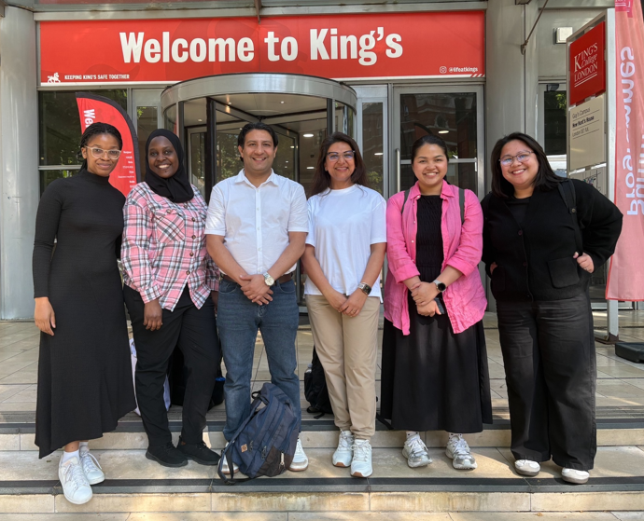
MSc Internationally Qualified Sonographers
E
L
First scholarship intake 2025 -26
‘fast track’ acknowledging past experience -supporting with academic and clinical requirements to obtain PG Cert General medical ultrasound.
Applications open April 2026 for next years intake
– sponsored by NHS

Slide 31
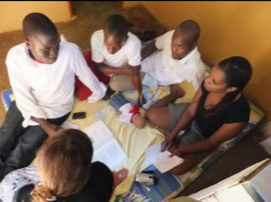

How I got here and my career pathway
Qualified BSc Radiography, 1999
PG Cert Clinical Education 2024
MSc Ultrasound 2023
NIHR Internship 2022
Qualified PG Dip 2010
Qualified PG Cert US 2009
Tutor Sonographer 2015
CPD
Notes:
Rad days – mozam
Achieving excellence in research and education
Mentorship and coaching
Created mentor course
Working with AHP other educators
Remain focused on clinical skills otherwise its difficult to teach – lots of admin and organizing planning. 1 session p/w clinical role and 2 for training.
During Covid years my research hat came on – contacting SOR with 101 ideas.
Put in touch with JM and involved in REP ALL WOMEN project – research priorities in pregnancy. Undertook NIHR research internship 2022. Completed MSc 2023 – on international recruitment of sonographers.
Not to neglect education focus – completed PG Cert Clinical Education 2024.

Slide 32

What I wished I’d known earlier
Practice education is great role
Busy.. Pressure between different needs
Students
Service needs
Practice Education is a huge field
– some leadership and management skills
- business cases, understanding finance
Document as you do!
Practice Education Accreditation Scheme – read before undertaking this scheme
Notes:
No regrets, bit fatalistic in my approach
Practice education is great role
Pressure tug o war
Good students training passing
Bad personalities, defensive, giving feedback, being responsible for career and future workforce
Bias
Conflicting role – supt, teaching lists vs waiting lists
Negotiation, undertsatning finance, procurement,
Working AHPs and against- demonstrating impact – documenting
PEAS – read before – clin ed.
Neurodiversity, digital,
Autonomy- balance - prioritisation
Role model – documentation – learn from others – teach others

Slide 33

What I wished I’d known earlier
Be aware you are a role model
Appreciation for the impact of practice educator
Include opportunities in PDR/PDP plans – use frameworks available
Shadowing other PEs within the workplace
Completing e-learning modules
You do not need to know everything but be able to facilitate learning
Scope for self development, inspire, drive change, innovative
Notes:
No regrets, bit fatalistic in my approach
Practice education is great role
Pressure tug o war
Good students training passing
Bad personalities, defensive, giving feedback, being responsible for career and future workforce
Bias
Conflicting role – supt, teaching lists vs waiting lists
Negotiation, undertsatning finance, procurement,
Working AHPs and against- demonstrating impact – documenting
PEAS – read before – clin ed.
Neurodiversity, digital,
Autonomy- balance - prioritisation
Role model – documentation – learn from others – teach others

Slide 34
References
Ultrasound-Practice-Educator-Guidance_D1-7
hcp_practice_education_guidance_3.pdf_2
AHP educators at Guys and St Thomas hospital NHS Trust
5 Models to Pull Out of Your Hat on a Moment's Notice - Endurance Learning

Slide 35
Advanced Practitioner Sonographer: Breast Imaging
Charmaine Salfarlie-Binns

Slide 36

How Do I progress My Ultrasound Career?
Breast Advanced Practitioner Sonographer
Charmaine Salfarlie-Binns
Notes:
Symptomatic clinic
Tripple assessment

Slide 37
Clinical Practice
Leadership and Management
Research
Education
Breast Advanced Practitioner Sonographer
Notes:
Development evolve around 4 pillars of advanced practice and within the Education and Career Framework
Focus on talking through what that looks like practically and key elements that should be included
Find relevant regardless of speciality interest

Slide 38
Clinical Practice
Skills | Skills
Clinical Assessment | Clinical decision making
Imaging | Communication
Intervention | Multi-disciplinary Team (MDT) Meeting
Autonomous Practice
Notes:
Palpate, lumps/bumps masses, puckering, redness, nipple discharge
Take history
Perform and advise imaging
Include, mammograms, tomosythesis, contrast enhanced mammograms, ultrasound and interpreting and reporting on those images
Interventional procedures
High level of autonomous practice and clinical decision making
High level of communication – Manage expectations, open, honest, sensitive challenge
Developing communication in MDT – Every Wednesday – discuss cases
Imposters syndrome – Oncologists, Radiologists, Surgeons, consultants – dread it
Heart pound if asked question
Out of comfort zone
Breath, practice, get better and confident

Slide 39
Leadership & Management
Skills | Skills
Lead US department | Develop protocols
Manage team | Operational
Develop services
Notes:
Looks different for everyone
Co Lead US department
Manage a team of sonogrpahers
Appraisals, teaching, procurement, develop services, protocols, operational level
Many not directly related to breast imaging
Most collaborative, working with people outside of radiology
But has collectively built my abilities as an advanced practitioner
Progressive skill
Opportunity to help develop others – build dreams, ambitions, career goals with knowledge, skills and experiences you have got

Slide 40
Education
Skills | Skills
MSc Medical Ultrasound | Leadership Course
Breast US and Intervention | Communication Course
Film Reading | Teach / Supervise / Mentor
Stereotactic Biopsy | Develop positive learning environment
Clinical Examination
Notes:
Specific educational achievements – Continue and never ends
Level 7
MRI reporting – PHD to advance to consultant sonographer
Education is not only clinical aspect
Advanced leadership and communication courses
Teaching and mentoring or coaching courses
Developing positive learning environments for others
Difficulties all clinical education with most universities are separate year long courses – takes time – research what is available

Slide 41
Research
Skills | Skills
Evidence based Practice | Case studies
Audit & Research Group
Research Projects
Notes:
Found this pillar challenging
All know our practice needs to be evidence based but how can I contribute to that, What do I need to do and how
Joined Trust Audit and Research group, observe, listen, see how others do it – Drs, radiographers, registrars present research ideas and projects
Build confidence
Tag onto existing projects CEM is as effective as breast MRI
Start writing up own case studies
Find you really get into it

Slide 42
Development Journey
Skills | Skills
Radiographer | MSc Ultrasound
Patient interaction | Breast Training
Autonomous | Ongoing
Career development
Notes:
Everyone's Journey different but can get to the same end goal
Many breast advanced practitioners mammographer background – I don’t
Working as radiographer about 10 years ago
Initially no plan
Shadowing in ultrasound, developed interest technical aspect, independent, reporting, much more patient interaction, see career developments and opportunities
Completed MSc medical US then showed interest at the trust I was working for in breast imaging
Reached out to breast consultant, applied for funding, trained me
Ongoing journey – Grab opportunities

Slide 43
Take-Outs
Plan
Challenges / Success
And Finally…
Allies
Acknowledge wins
Proactive
Notes:
Wish I knew important to acknowledge the small wins – assignment, study, getting through the day especially dealing with life outside of work
Plan, write down goals and objective and highlight to self when achieved – these may change – okay
Proactive from start, volunteer in breast imaging units, read up, observe MDT, reach out to others in field and build allies to support
Don’t be afraid of the challenges – Some of biggest also biggest success
Many like me first one to pursue AP roles in your trust
You see vision, write protocols, PGD’s convince higher powers you offer benefit department, patients and you do Dr’s do, it a long slow process
Life long journey but rewarding

Slide 44
Thank You
Any Questions

Slide 45
Extending the Sonographer Role and Voice in Early Pregnancy
Roxanne Sicklen

Slide 46

My role
Been a qualified sonographer for almost 20 years
Long standing special interest in gynaecology and early pregnancy
Ambition to be a consultant sonographer within this specialty
I work part-time as a clinical specialist sonographer, part-time as a senior teaching fellow at KCL
I’m a mum of 3 boys!

Slide 47



My role
I am the sonographer representative on the executive committee of the Association of Early Pregnancy Units AEPU
Through this role, in association with the Society of Radiographers, we have created…

Slide 48
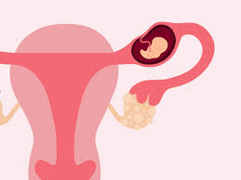
Why Early Pregnancy and Gynaecology?
Although many sonographers perform these scans, proficiency is variable
Women suffer - BUT we can change lives if we do the job well
Communication is essential
Challenges me and stretches my brain
It chose me!

Slide 49
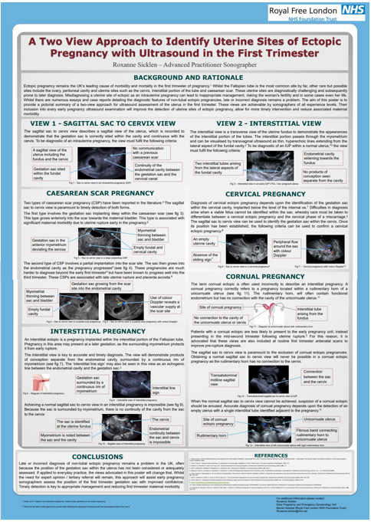

My career pathway
Created a poster - present as AEPU ASM
Career path decision
Other opportunities arose – I always said ‘yes!’
Asked to speak at RCOG SITM
Applied for COR advanced practitioner accreditation (2017)
Now a member of multiple national professional groups
I still don’t have the job title ‘Consultant Sonographer’!!!

Slide 50
How I got here
Clinical Expertise
Scan specialist endometriosis lists
Scan MDT patients requiring a second opinion
Asked to scan the gynaecologists / their daughters!
Asked to scan the complex early pregnancy cases in Consultants absence.
Leadership
Member of multiple professional groups (AEPU, BMUS, SOR UAG)
Contributed to national guidance, including NICE guideline updates
Offered opportunities to others
Recognised sonographer expert in aspects of gynaecological and early pregnancy scanning.
Education
Now hold formal education role at KCL
Co-organiser of advanced gynaecology ultrasound course
Have spoken internationally at various educational events
Teach others to scan (radiologists, gynaecologists, sonographers)
Research/service development
Contributing author to ASCKS framework
Reviewer for Radiography journal
Perform audit and QI projects within clinical role
Long term aim to complete a PhD!
Focusing and refining my scope of practice
Taking all opportunities that have been offered
Followed my passion – this is not a chore
Constant desire for improvement

Slide 51

What I wished I’d known earlier
Pre-trodden paths are easier to navigate (but someone has to be the first!)
There’s a lot of misunderstanding of advanced / consultant practice
Not everyone will help you, always try to help others
Take opportunities – step outside your comfort zone
Enjoy the journey!

Slide 52

Thank you for listening

Slide 53
Beyond the Screen: Investing in Your Future Career
Nicki Davidson

Slide 54
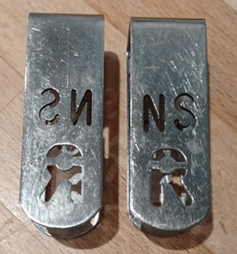
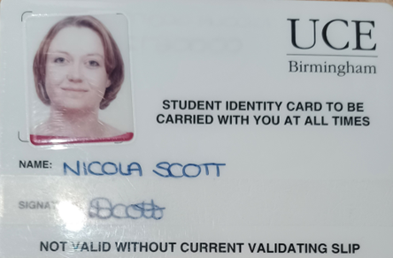

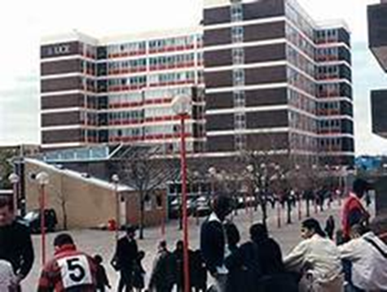
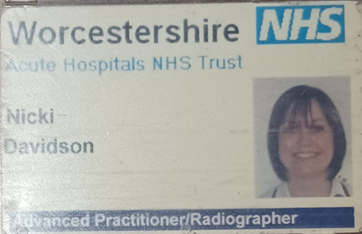
My Journey…
Initially, trained as a pharmacy technician working at Selly Oak Hospital, Birmingham.
Commenced Radiography training University of Central England, Birmingham in 2000.
Qualified as a Diagnostic Radiographer in 2003, first post at Worcestershire Acute NHS Trust
PG Cert in Medical Ultrasound in 2006
PG Diploma in 2007
Sonographer post in Worcestershire Acute NHS
Part Time / Job Share Lead Sonographer role in Oct 2012

Slide 55
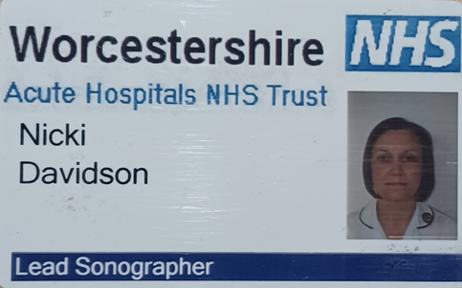
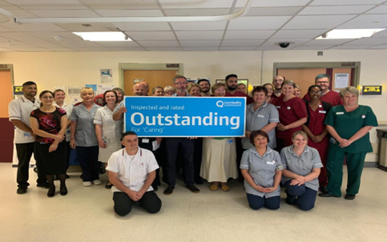
My Role
Countywide service with 2.6 WTE Leads
23.6 WTE staff (32 Sonographers & Students)
19 US rooms
6 sites
Obstetric and NOUS service
Responsible for:-
Clinical leadership of the US service
Waiting list management /pathways
Service development & maintenance
Staff recruitment & development
Governance
HR Duties & Investigations
Pay / e-roster
Network development and MDT working
any other ad-hoc duties……….

Slide 56
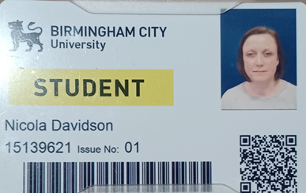
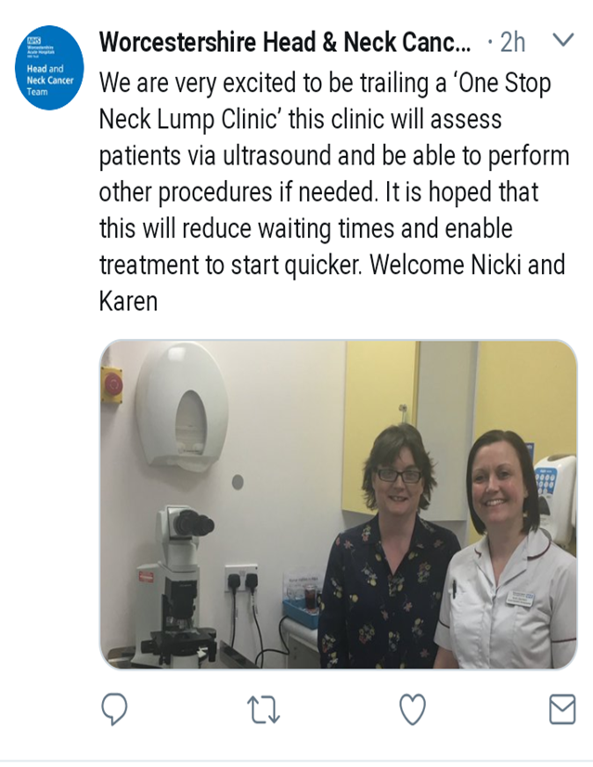
My career pathway
Sonographer since 2006. Obs / Gynae / General Abdo / DVT.
Lead Sonographer since 2012.
In 2014 – I was given the opportunity to train to do H&N US.
In 2015 we wanted to develop this to include FNAs – was told no!
In 2015 I did an MSc with a management project “Developing a Sonographer FNA Service”
In 2016, got agreement from Radiologists and commenced training
In 2017 started a trial of a Sonographer led – One Stop Neck Lump Clinic. This has been running ever since.
In 2018, I needed a new challenge!

Slide 57
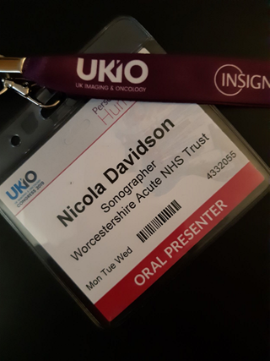

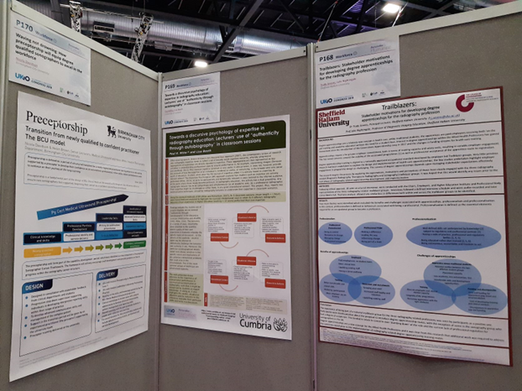
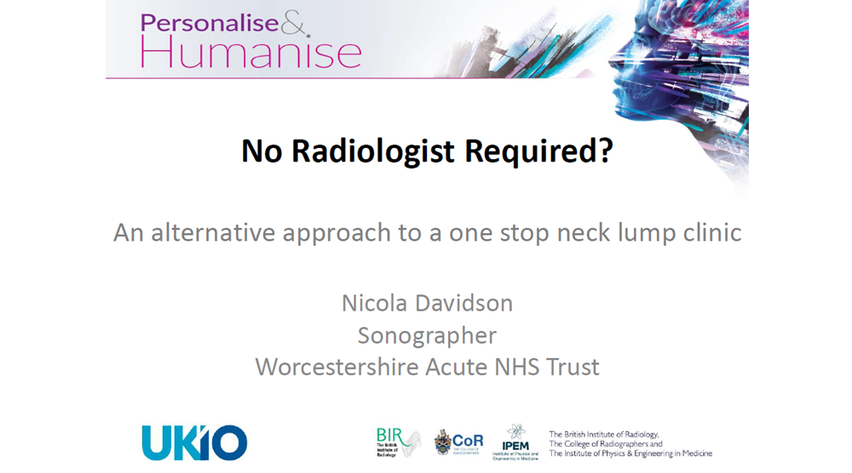
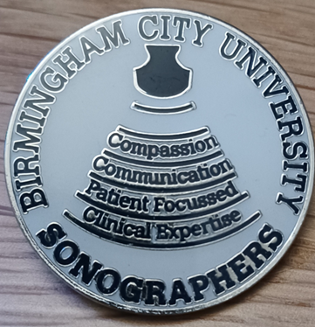
No opportunity for AdvP role development
Part-time Senior lecturer role at BCU
Course Lead for PG Abdominal US and PG Certificate Preceptorship (Medical Ultrasound)
Attendance for first time at UKIO
First Conference Poster
First Proffered Paper
Keynote Lecture –that changed everything!

Slide 58
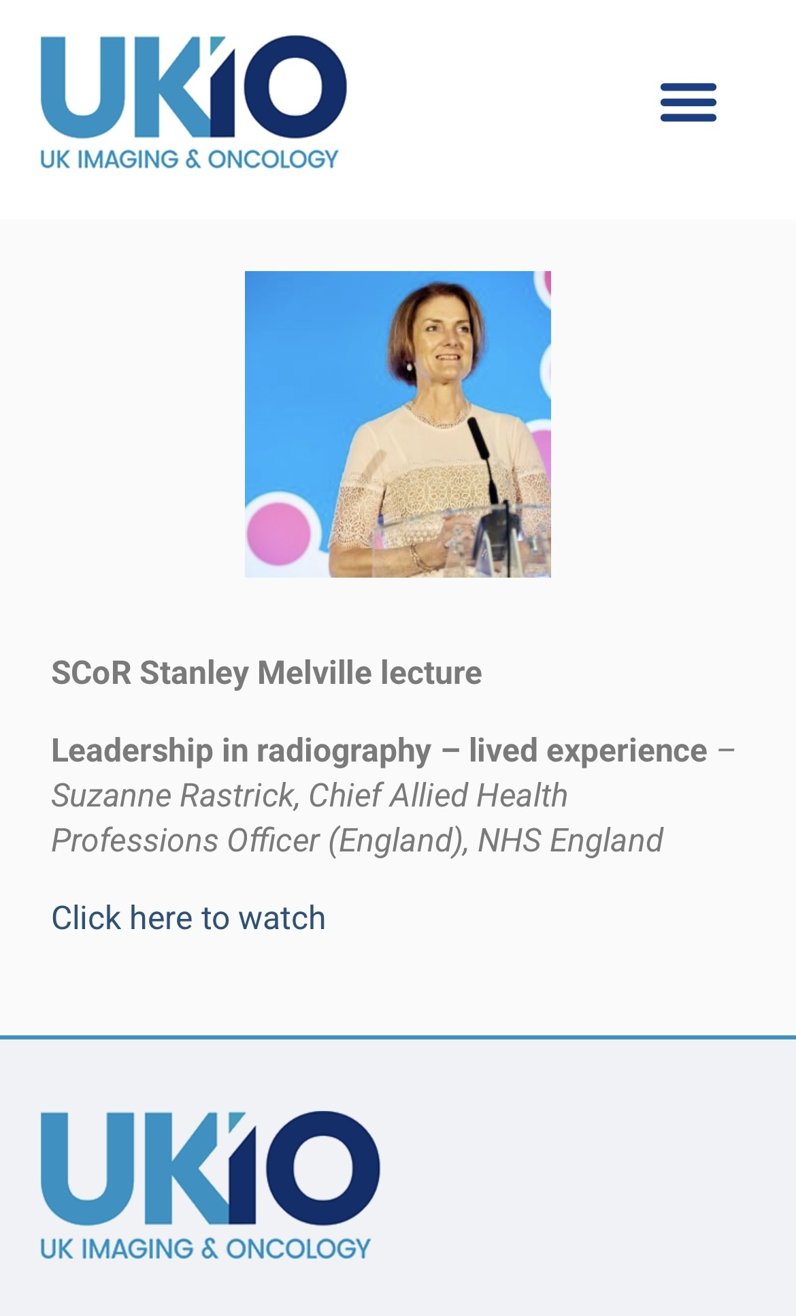
Key note lecture by Suzanne Rastrick – Chief AHP
Leadership in Radiography
Took statements from well-known Radiography Leaders such as Prof Bev Snaith, Dr Nick Woznitza, Tracey Ellis, Catherine Kirkpatrick and Penny Owens
“decide what you want to be known for and what you want to be best at. The role may not exist but if you gain the skills and knowledge when the gap arises you will be the person to fill it”
Time and effort will generate opportunity

Slide 59
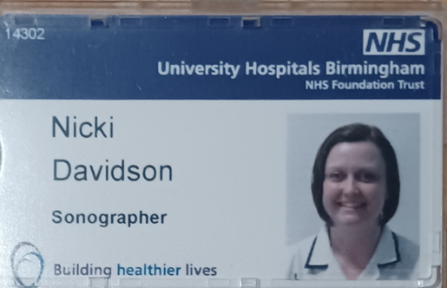
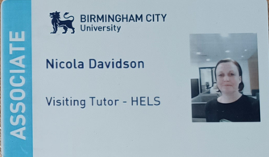
What next …..
Developed module and got approval for PG Cert in Preceptorship (Medical US)
Completed a book review about an abdominal US book and was then asked to become editor of the next edition!
Left BCU after 1 year
Took a temporary sonographer role part-time at Queen Elizabeth Hospital Birmingham, wanting to develop H&N US role alongside specialist consultants
Visiting lecturer role at BCU
2020 – COVID. My role as a manager to support my team became the most important thing and other goals were put on hold.

Slide 60


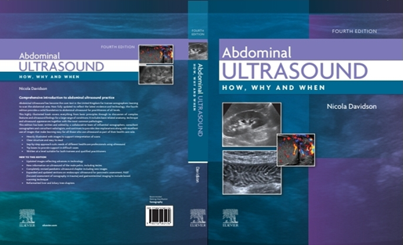
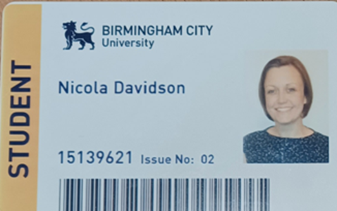
2021 – Started a Professional Doctorate (temporarily!)
2021 – Applied to SoR Ultrasound Advisory Group
2022 – Full time at WAHT including AdvP role
2022 – Book published
2023 – Applied to NHSE for AdvP accreditation
2024 – NHSE AdvP Accreditation
2025 – WM Imaging Network NOUS Chair
2025 – Second term with UAG – workstreams on GPDA
2025 – Networking and working alongside WMCA projects
Plus invites to speak at study days and conferences …….

Slide 61

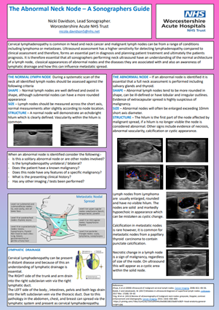
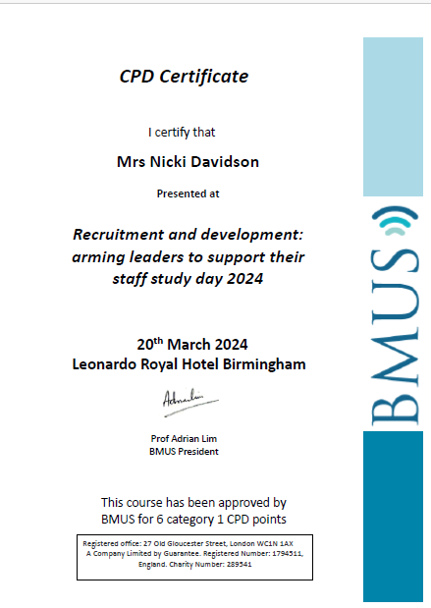





Opportunities started to come …..

Slide 62



Slide 63
What have I learnt…..
I am 100% a Sonographer – I love working clinically
I am really proud of my team and the department I work in.
I really enjoy my leadership role, supporting the team and being able to influence what happens
Advanced practice is one career route, but there are other opportunities out there for a rewarding career.
Sometimes you need to try things to see if they are right for you.
You won’t always get the recognition you want from those around you – decide what is important for you and stay true to what you aiming for.
Find a mentor who can guide and challenge you.
Develop / find a network of like-minded sonographers – they will be your motivation!
Don’t give up because someone says ‘no’. Managers change, new services are introduced and an opportunity may be around the corner.

Slide 64

My advice…….
Be brave …. Try new things, it may not work out but it helps you to clarify what is important
Say yes!!! Don’t let imposter syndrome get in your way. Saying yes to something now may lead onto to future opportunities
Put yourself forwards, apply for something new, increase your network this will help people know who you are!

Slide 65
Good luck …..
nicola.davidson5@nhs.net

Slide 66
Setting up an Endometriosis Clinic and Becoming a Gynaecology Expert
Becky Slough

Slide 67
My role
Clinical Specialist Sonographer in Gynaecology
Clinical
Working at CUH with 9 years’ experience, specialising in endometriosis
Active member of Gynaecology Oncology MDT and Endometriosis MDT Educational
Train radiology registrars, clinical fellows, and sonographers in general gynaecology and advanced endometriosis ultrasound
Deliver education through local teaching, and national & international presentations Leadership
Lead implementation of new guidelines and standardised gynaecology reporting templates
BMUS Travelling Ambassador, supporting departments nationwide with endometriosis training, protocols, and service development

Slide 68
My career pathway
Discovered a strong interest in gynaecology early in ultrasound training, supported by a highly motivated radiology team
Curiosity around endometriosis developed organically through clinical findings and multidisciplinary discussion
Chose to focus fully on gynaecology, stepping away from obstetrics to complete an MSc and undertake
primary research
Developed and piloted a systematic ultrasound approach to endometriosis, aligned with existing MRI reporting frameworks
Research led to the implementation of a dedicated endometriosis ultrasound service, supported by departmental leadership
Career progression evolved through passion, opportunity, and advocacy, leading to national teaching, service development, and international presentation

Slide 69
How I got here
Actively sought learning beyond core training (extra reading, MDT discussions, subspecialty interest)
Invested in formal education (PgDip → MSc) aligned to a clear clinical gap
Used research to solve real clinical problems, not just to gain a qualification
Built strong relationships with radiologists, MDTs, and management
Took opportunities to teach, present, and share knowledge locally and nationally
Said yes to opportunities that felt challenging but aligned with my values and passion

Slide 70
What I wished I’d known earlier
You don’t need a fully mapped-out career plan — curiosity and consistency matter more
Becoming really good clinically opens more doors than chasing job titles
It’s okay to specialise early if there’s a genuine service need and passion
Your ideas are valid before you feel like an “expert” — share them
Relationships, mentorship, and MDT working accelerate progression
Saying no (and protecting your energy) is part of sustaining a long career

Slide 71
What I’d do again / What I’d do differently
What I’d Do Again
•
•
•
•
•
Follow genuine clinical interest, not what felt like the “expected” pathway Invest in postgraduate education and research with real clinical impact Build strong working relationships with radiologists, MDTs, and managers Say yes to teaching, presenting, and sharing knowledge early on
Focus on becoming clinically excellent and credible before chasing titles
What I’d Do Differently
•
•
•
•
•
Seek out mentorship earlier, rather than figuring things out alone
Share work and ideas sooner, instead of waiting for them to feel “perfect”
Be more confident in owning expertise, especially in gynaecology Protect time and boundaries better to avoid burnout
Recognise earlier that progression isn’t linear — and that’s okay

Slide 72
Setting up an endometriosis service – key steps
Identified a clinical gap in structured ultrasound assessment and reporting
Reviewed existing pathways and aligned reporting with established MRI frameworks within the trust
Developed a systematic scanning protocol and standardised reporting template
Piloted the framework through MSc research in a real clinical setting
Presented findings to MDT and management to secure support for implementation
Embedded training and education to ensure service sustainability and consistency

Slide 73
Impact of the service
Improved pre-operative planning and surgical confidence
Standardised reporting for pre- and post-menopausal patients
Strengthened ultrasound’s role within MDT decision-making
Increased departmental expertise in advanced gynaecology imaging
Enabled national dissemination through teaching, ambassador roles, and conference presentations

Slide 74
How Do I Progress My Ultrasound Career in the Innovation Era?
Dr Jackie Matthew

Slide 75
How Do I Progress My Ultrasound Career in the Innovation Era?
Dr Jackie Matthew, King’s College London | Fraiya Ultrasound

Slide 76





My role
Clinical, Research & Innovation, Industry and Entrepreneurship
Chief Medical officer and Co-founder Fraiya
Senior Research fellow KCL
Clinical translation US and MRI
AI/Machine Learning, computer vision
Women’s Health
Screening/ diagnosis
Health inequalities
Innovation & Entrepreneurship
Clinical
Research -Imaging Sciences
AI Clinical Trials
Spinout company

Slide 77


My role
Lots of transferable clinical skills but also many technical skills
see section 9: ECR for the Radiography Workforce
Clinical
Research -Imaging Sciences
AI Clinical Trials
Spinout company

Slide 78




My career pathway
Past
Present
Future
Clinical Radiographer/ Sonographer
NIHR clinical doctoral research fellow
Research Sonographer
Educator/mentor
Research interests AI/US/MRI
???
Chair/member of AI/Research Advisory group (SCoR)
Start up co founder and clinical lead
PI Clinical Imaging Research studies
Clinical safety officer
NIHR Research Training Fellow (MRes)
NHS clinical entrepreneur fellow
Not a straight path!
How can we solve some of our key challenges?

Slide 79
How I got here
Research and Evaluation
Expert Clinical Practice
Education, Training and Practice Service Development
Professional Leadership and Consultancy
Research Training
PhD supervision
Mentorship
Diagnostic test accuracy statistics
Clinical Trials
Focus Groups
Health Economics
Implementation Science
Technical Training
Machine Learning Course
Clinical Training
Specialist Rotation:
3 monthly (US and MRI clinics)
Short Courses:
US (specialist training e.g. neurosonography)
Genomics in Medicine
Fetal MRI workshop
Antenatal Counselling
Engagement with local teams
Multidisciplinary team meetings
Leading fetal imaging educational review meetings
Service development training
Capacity, flow and demand
Advanced Research in Practice
Conferences and overseas visits
ISUOG
Cleft/craniofacial congress
European Radiology Conference
LA Overseas Visit
Skills training
Product Management Training
Influencing beyond your role

Slide 80
Multidisciplinary trial and MRes Advanced Clinical Research Methods
£10, 000 000 funded innovation in health and engineering award from Wellcome Trust and EPSRC
7 year project – completion 2022
Basic science/clinical translation project in fetal imaging
Multidiscipinary – sonographers, radiographers, radiologists, fetal medicine and fetal cardiology specialists, biomedical and computer engineers, physicists

Slide 81






10 year journey - Bench to Bedside to Boardroom
Prototype
Improved accuracy of 18⁺⁶ – 20⁺⁶ scan
US
MRI
Computer aided assessment
Robotics
Clinical
The overall aim of the iFIND project was to combine innovative technologies into a clinical US system that will lead to a radical change in the way fetal screening is performed
Notes:
Fraiya was built to address this problem head-on, and the journey began within the iFIND Project—a £10M initiative funded by Wellcome and EPSRC in 2014 - 2024.
Despite being a basic sciences and engineering project – there was an important clinical translational arm with genuine multidisciplinary collaboration with midwives, fetal medicine specialists, radiology, fetal echocardiology specialists, engineers, data scientists, software developers and of course sonographers/radiographers. To me the most practical innovation that could have an impact TODAY is what Fraiya offers.
Our early development was supported by a Wellcome Trust Tech Accelerator Award, and last year, acceptance onto a competitive accelerator scheme from Cedars-Sinai in the US, and translational support from NIHR doctoral fellowships for myself and Dr Tom Day, an EPSRC IAA commercialisation grant and of course overarching support from the medtech venture scheme here at the LIHE. Together, this infrastructure helped us transform research assets into deployable technology and IP.

Slide 82

My advice
It’s OK to be a bit different!
Researchers and leaders!
Entrepreneurial traits
* self-efficacy * conscientiousness
* openness to experience * risk taking propensity * locus of control * extraversion
* need for achievement * innovativeness
* agreeableness * neuroticism
Yangailo T, Qutieshat A. Uncovering dominant characteristics for entrepreneurial intention and success in the last decade: systematic literature review. Entrep Educ. 2022;5(2):145–78.

Slide 83

Healthcare Entreprenurship is a growth area
Clinical insight → innovation → business strategy
Innovator: recognising and shaping novel technologies, services or models (e.g., digital health, AI, new care pathways)
Integrator: bridging clinical, technical, regulatory, commercial domains – aligning health-system needs, user adoption, reimbursement, regulation
Value-creator: not just through product but through improved outcomes (better care, cost-efficiencies, access), thereby convincing stakeholders (NHS/health systems, payers, regulators)
Change-agent: challenging status-quo care models (e.g., hospital-centric, fee-for-service) and enabling new care delivery paradigms (remote monitoring, predictive analytics, patient empowerment)
“Entrepreneurship: the application of enterprise behaviours, attributes and competencies into the creation of cultural, social or economic value. This can, but does not exclusively, lead to venture creation.“

Slide 84
Relatively little research on the clinical workforce and entrepreneurship
Sonographers often work in relative isolation
with fragmented links to wider pathways or environments with strong exemplars in leadership and innovation. [2]
Frontline staff who innovate can be seen as disruptive
Training is largely clinically focused
with little explicit training in entrepreneurship, service redesign or commercial thinking [1]
Potential “intrapreneurs” report a lack of recognition, mentoring & practical support to develop ideas – many leave the NHS [3]
Explicit drive to increase NHS entrepreneur and intrapreneurship
via the longstanding NHS Clinical Entrepreneur Programme – 10th cohort! [3]
Entrepreneurship in imaging is often framed as solving real systems problems
i.e. workflow, equity, access, it’s not just about creating products [4]
Mercer, C.E. et al. (2024) Entrepreneurial thinking in radiography: Developing an imaging facility to support the future workforce. Radiography, Volume 30, 74 – 78
Griffiths et al (2024) Development of sonography practice to accelerate patient care. UWE Bristol/NHS England
Holland Brown et al. (2025) Insights from the NHS England Clinical Entrepreneur Programme BMJ Innovations Vol11:35-40.
Itri J.N., et al. (2015) Entrepreneurship in the Academic Radiology Environment,. Academic Radiology,

Slide 85

What I wished I’d known earlier

Slide 86
1. You are an integral part of the care pathway, not “just” a cog in a giant machine
Understand the whole care journey
– from referral, counselling, complementary imaging, MDT, genetics, intervention, follow-up.
Where ultrasound actually create friction or value? Ideation
Develop and champion your professional identify
- key to achieving ‘voice’ and evolving the profession thus improving service outcomes
Miles, N., Cowling, C. and Lawson, C. The role of the sonographer - An investigation into the scope of practice for the sonographer internationally; Radiography 2022 Feb;28(1):39-47.

Slide 87
2. It’s good to develop your “micro-innovation muscle” locally
Entrepreneurial readiness grows from small, local changes – workflow tweaks, patient communication tools, audit-driven protocol changes
This is intrapreneurship – i.e. service improvement and idea testing IN the NHS
Williams C. NHS innovation must value staff and inspire hope BMJ 2023;

Slide 88
3. Find your tribe – don’t try to innovate alone
Network, network, network
Find local clinical and non-clinical champions for clinical AI and tap into existing networks - AI ambassador network, Alan Turing Clinical AI group, NHS innovation networks, NHS CEP
Arora, A., et al. (2021) Innovation Pathways in the NHS: An Introductory Review. Ther Innov Regul Sci 55, 1045–1058

Slide 89

Making use of networks and research infrastructure
Supervisors, researchers, peers, PPI and mentors, professional groups
Local Clinical Research Network
Applied Research Collaboratives
Specialty therapy areas
Health Innovation Networks
Research Support Service

Slide 90
4. Learn the basics of “how ideas seed and scale” in the NHS
Build entrepreneurial competencies like stakeholder mapping, value proposition, and basic health economic evaluation
Who actually owns the problem? (directorate, ICS, screening programme?)
Who pays for solutions? (commissioners, Trust, philanthropy?)
What evidence is needed? (audit vs QI vs research vs commercial evaluation?)
Arora, A., et al. (2021) Innovation Pathways in the NHS: An Introductory Review. Ther Innov Regul Sci 55, 1045–1058

Slide 91

5. Protect yourself: governance, IP and conflicts of interest
Need for clear structures, IP support and conflict-of-interest guidance – this is improving
Talk early to NHS R&D, innovation and IG offices about your innovation and IP
Good governance is protective, especially if you plan to work with industry later
https://www.gov.uk/government/publications/intellectual-property-ip-guidance-for-the-nhs-in-england/intellectual-property-ip-guidance-for-the-nhs-in-england

Slide 92
6. Aim for equity and patient partnership, not just cool tech (shouldn’t be a problem for clinicians?)
Entrepreneurship can be used as a tool to tackle inequalities and improve access in the NHS – especially for underserved groups
Sonography emphasises patient care, good communication and the emotional load within practice – making it a rich space for co-designed PPI
Donia, J., & Shaw, J. A. (2021). Co-design and ethical artificial intelligence for health: An agenda for critical research and practice. Big Data & Society, 8(2)

Slide 93



Summary

Slide 94






Thank you
Follow our journey on LinkedIn
St Thomas’ Accelerator
M​edTech Venture Builder
Tech Accelerator, Los Angeles, August 2024

Slide 95
From Clinical Practice to Ultrasound Education: An Adventure
Prof Gill Harrison

Slide 96



My role as an academic

Slide 97
My role as an academic
Curriculum design & development
Planning, preparing, writing course documents
Involving stakeholders & gaining CASE accreditation
01
02
Recruitment & timetabling
Marketing, recruitment, student interviews, placement agreements, room bookings
Lecturing
Planning, delivering and evaluating feedback, tutorials, seminars, skills sessions, PE training
03
04
Assessments
Planning, writing exams, marking & feedback
Assessment boards and external examining
Research
Supervision, involvement in projects
Local, national, international
05
06
Educational leadership
Lead for Teaching Excellence – feedback toolkit
Innovations, mentor & coach

Slide 98
My career pathway
Sono
Teach
Lecture
Wider skills
Progress
Ultrasound experience
Practice educator
Lecturer / clinical co-ordinator
Internal / external roles
Keep developing
Clinical skills & leadership / management
Teach, assess, mentor in clinical
PgC and on-the job training.
FHEA
Research, mentor, coach, innovation, CASE, SoR, EE, BMUS, SFHEA
Continue developing
LTE role, PFHEA
Associate Prof.
Notes:
This is where you can talk about whether you had a planned career pathway or if you just ended up there
Was it planned?

Slide 99

How I got here
Professor
Programme lead
Lecturer various universities UK and Vienna
Chair exam boards, academic misconduct, FtP
Medico-legal expert witness
EFRS Medical Imaging Committee
International teaching: Uganda and Rad-Aid
Professional Officer
Chair NHSE Sonographer training group
Sonographer Implementation Group
Guidance, policy, lobbying, consultations
08
01
Awards
VC award for Excellence in Learning and Teaching
Curriculum development
Teaching innovations
Student support
Conference presentations
Best abstract by a radiographer ECR
Poster presentations
Lead for Teaching Excellence
Principal Fellow of the Higher Education Academy
Strategic educational leadership within the School of Health Sciences and ultrasound community
07
02
Research and Publications
Deputy editor - Ultrasound
~ 50 journal articles
Conference presentations UK and international
Chair EFRS ultrasound research group
Research supervision
Ultrasound text book
06
CASE and AAB
Training lead
Committee member
Lead accreditor
Co-author CASE Standards for Sonographic Education
AAB assessor
03
05
04
Coach
Imposter syndrome practitioner
Leadership coach
Clinical hypnotherapist
Sonographer
Ultrasound manager
Consultant sonographer at private clinic
Notes:
Include some of the relevant things you did to get you to this point in your career / this role

Slide 100


What it’s not
“Have a lovely summer break”

Slide 101


Portfolio careers are a thing
What I wish I’d known earlier
You don’t have to focus on just one thing (but you can)
Importance of qualifications & output – learning the ‘rules’
Interested in becoming an academic?
PgC in T&L is essential. Advance HE Fellowship
Research in teams is important
Gain experience: associate, visiting, honorary role
Academic teaching
Clinical teaching
Assessor
Co-supervisor
Shadow experienced academics
Get a teaching qualification
CASE accreditor role
External examining
All experience counts
Never know when it will be useful
Networking
Team working, collaboration and wider networking is key to developing education and research within an academic career.
You don’t have to do it alone. Stronger together
Notes:
If there’s something you realise would have been useful to know earlier in your career this is where you can share that with the audience to help them save time and get there quicker.

Slide 102


One last thing I wish I’d known earlier
Is this the face of an imposter?

Slide 103
Introduction to the ECF and the Sonographer Career Framework
How You Can Use These to Plan Your Career

Slide 104

Feedback

